Slide 1

The Shadow We Cast

Slide 2
What will we talk about?
We’ll examine some of the uses of shadows in the Bible, and how they convey both positive and negative concepts
We’ll reflect on the three general “ingredients” to making a shadow and some possible spiritual applications for them
We’ll consider some of Stephen’s traits and how they helped form a shadow that others recognized as reflecting a heart that was consecrated to God
Lastly, we’ll reflect on how the shadow cast by Paul, and how it continues to provide a beautiful example for consecrated hearts today to follow

Slide 3
The Shadow We Cast: “Shadow” in the Bible

Slide 4
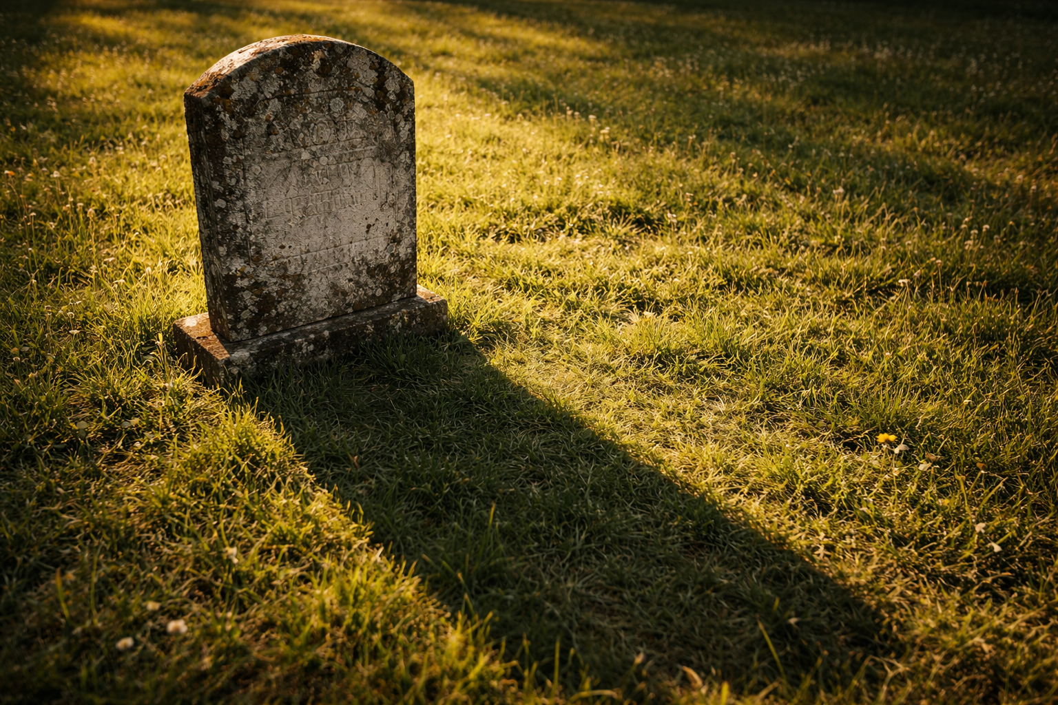
Negative Connotation: The “shadow of death”
Job 3:5 Let darkness and the shadow of death stain it; let a cloud dwell upon it; let the blackness of the day terrify it.
Psalm 23:4 Yea, though I walk through the valley of the shadow of death, I will fear no evil: for thou art with me; thy rod and thy staff they comfort me.

Slide 5
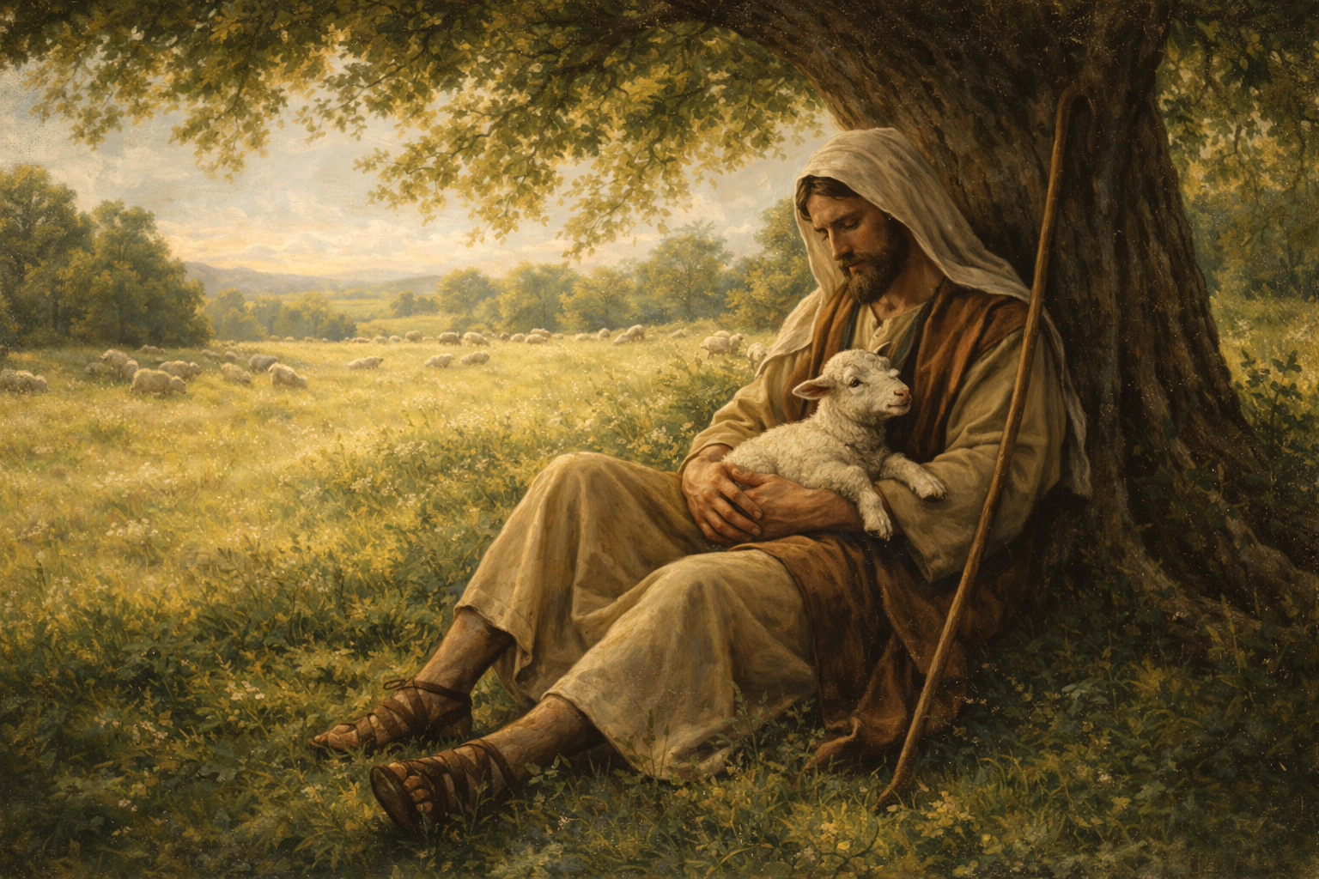
Positive connotations of shadows
Psalm 17:8-9 Keep me as the apple of the eye, hide me under the shadow of thy wings, from the wicked that oppress me, from my deadly enemies, who compass me about.
Psalm 36:7-8 How excellent is thy lovingkindness, O God! therefore the children of men put their trust under the shadow of thy wings. They shall be abundantly satisfied with the fatness of thy house; and thou shalt make them drink of the river of thy pleasures.
Psalm 91:1-2 He that dwelleth in the secret place of the most High shall abide under the shadow of the Almighty. I will say of the LORD, He is my refuge and my fortress: my God; in him will I trust.

Slide 6
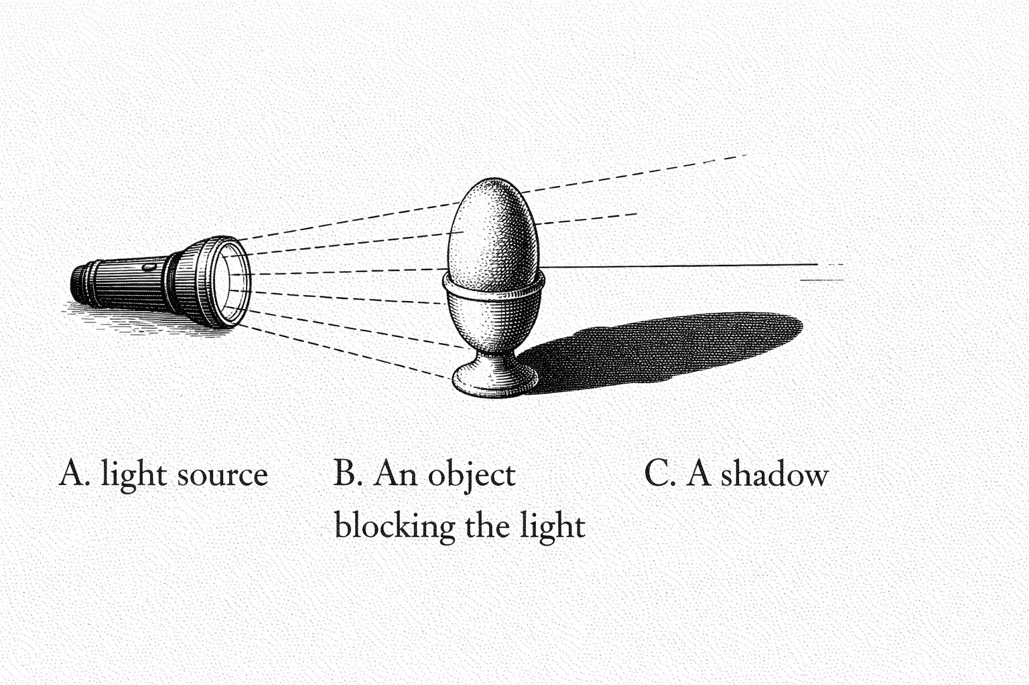
A light source
An object to block part of that light to create the shadow
Something for the shadow to fall upon

Slide 7
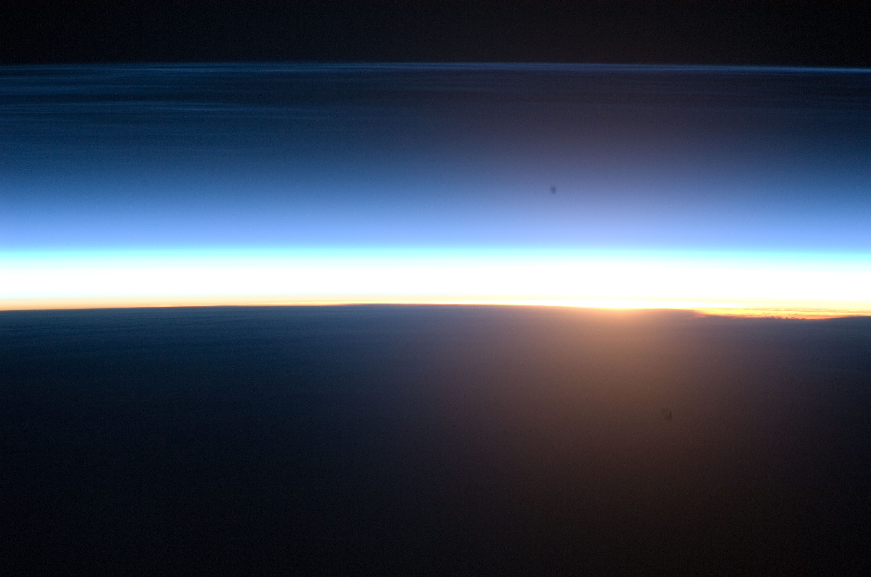
Casting a Shadow: God As Our Light Source
1 John 1:5-6 This then is the message which we have heard of him, and declare unto you, that God is light, and in him is no darkness at all. If we say that we have fellowship with him, and walk in darkness, we lie, and do not the truth:
Psalm 46:1 God is our refuge and strength, a very present help in trouble.

Slide 8
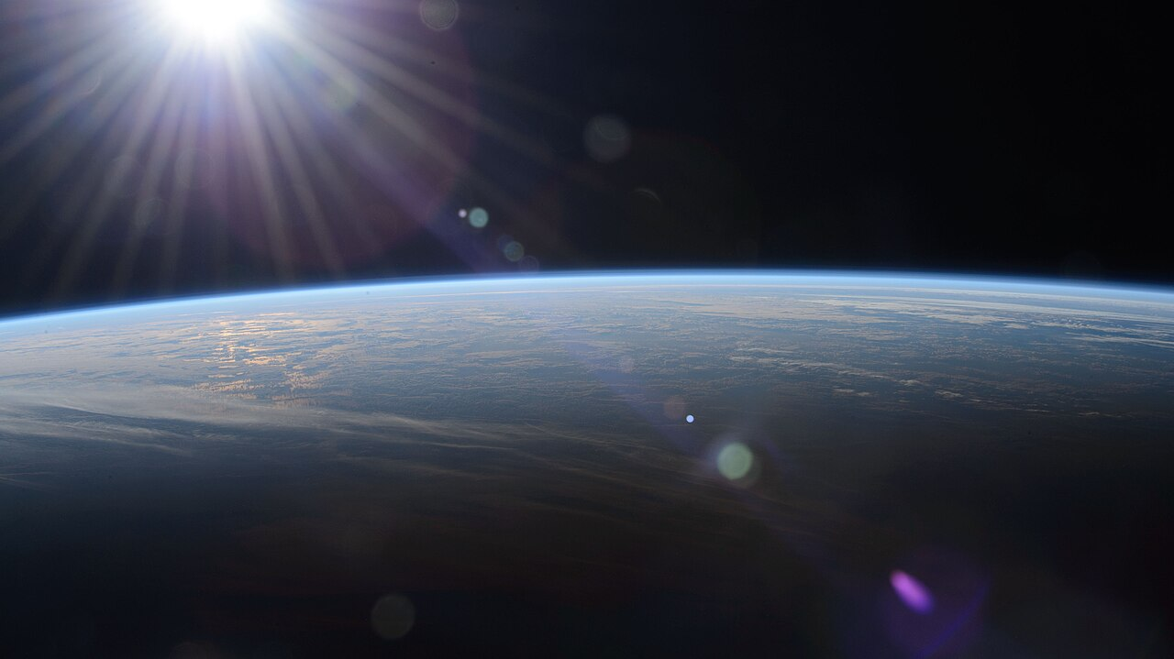
Casting a Shadow: God As Our Light Source
James 1:17 Every good gift and every perfect gift is from above, and cometh down from the Father of lights, with whom is no variableness, neither shadow of turning.
James 1:18 Of his own will begat he us with the word of truth, that we should be a kind of firstfruits of his creatures.
Isaiah 55:11 So shall my word be that goeth forth out of my mouth: it shall not return unto me void, but it shall accomplish that which I please, and it shall prosper in the thing whereto I sent it.

Slide 9
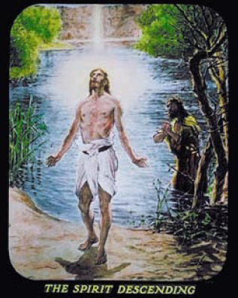
Casting a Shadow: Jesus As Our Light Source
John 8:12 Then spake Jesus again unto them, saying, I am the light of the world: he that followeth me shall not walk in darkness, but shall have the light of life.
John 14:6 Jesus saith unto him, I am the way, the truth, and the life: no man cometh unto the Father, but by me.
John 10:30 I and my Father are one.

Slide 10

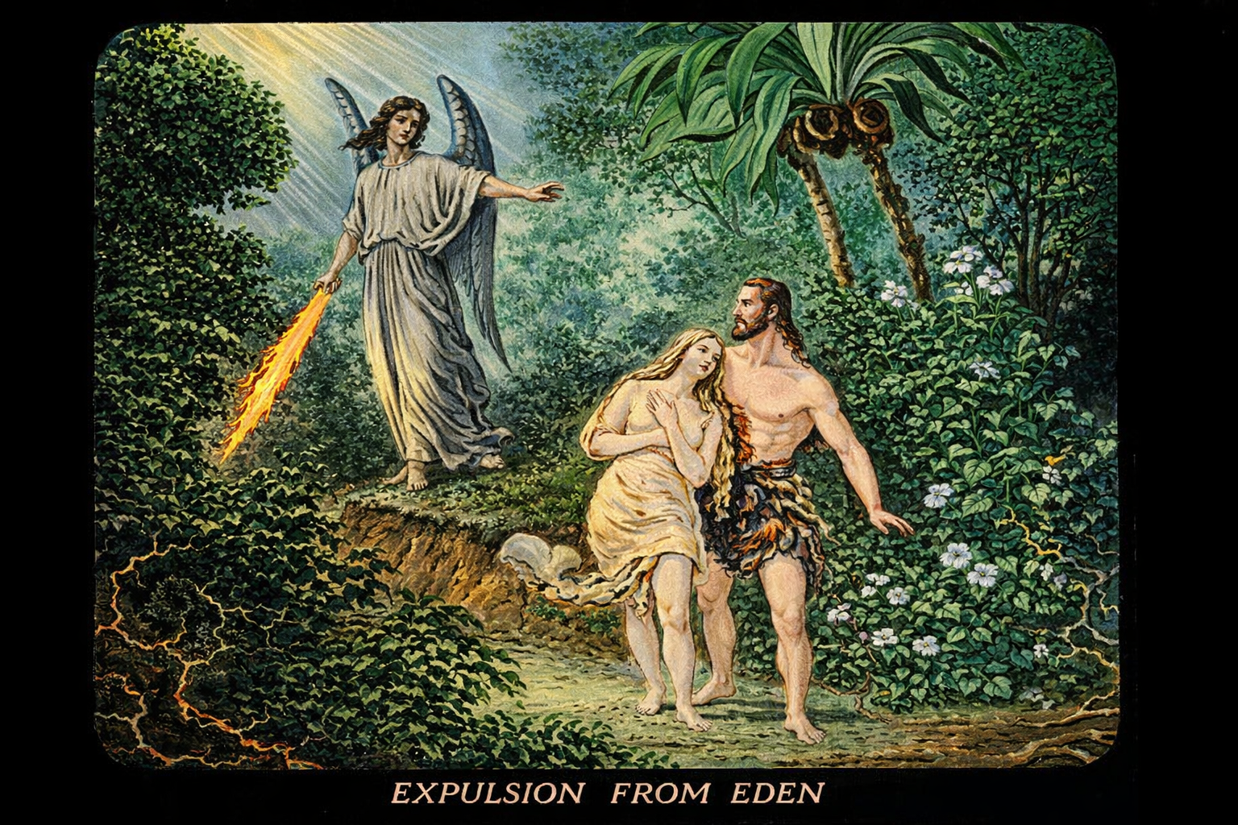
Casting a Shadow: Standing in the Light
1 Peter 2:9 But ye are a chosen generation, a royal priesthood, an holy nation, a peculiar people; that ye should shew forth the praises of him who hath called you out of darkness into his marvellous light;

Slide 11
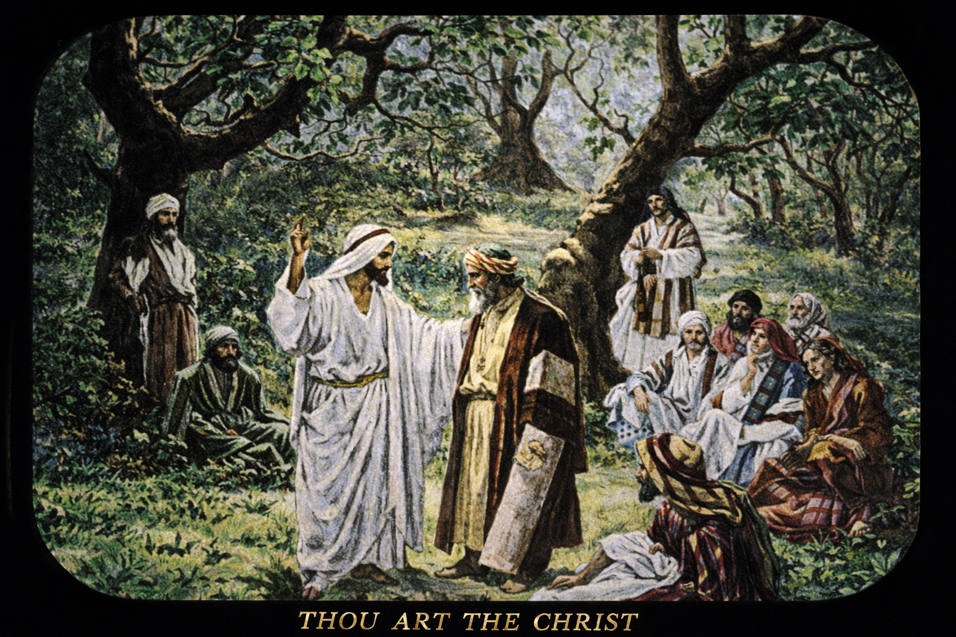
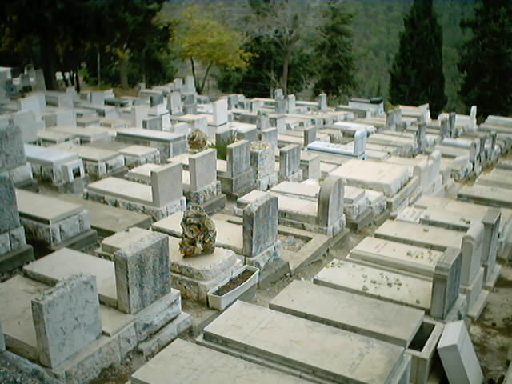
Casting a Shadow: Standing in the Light
Romans 6:23 For the wages of sin is death; but the gift of God is eternal life through Jesus Christ our Lord.
Romans 6:23 For the wages of sin is death
Hebrews 10:31 It is a fearful thing to fall into the hands of the living God.
1 John 2:1 My little children, these things write I unto you, that ye sin not. And if any man sin, we have an advocate with the Father, Jesus Christ the righteous

Slide 12
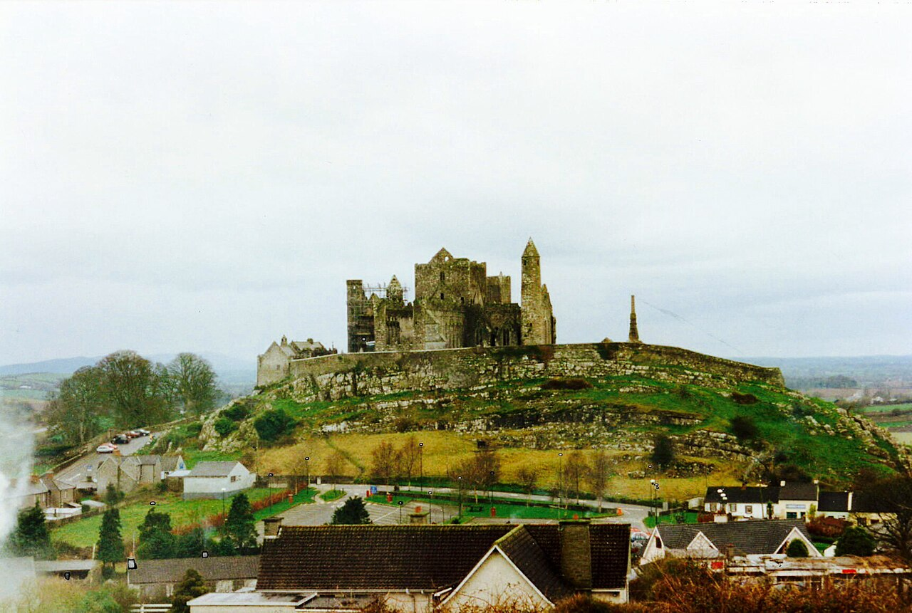
Matthew 5:45 That ye may be the children of your Father which is in heaven: for he maketh his sun to rise on the evil and on the good, and sendeth rain on the just and on the unjust.
Matthew 7:24 Therefore whosoever heareth these sayings of mine, and doeth them, I will liken him unto a wise man, which built his house upon a rock:
John 14:15 If ye love me, keep my commandments.

Slide 13
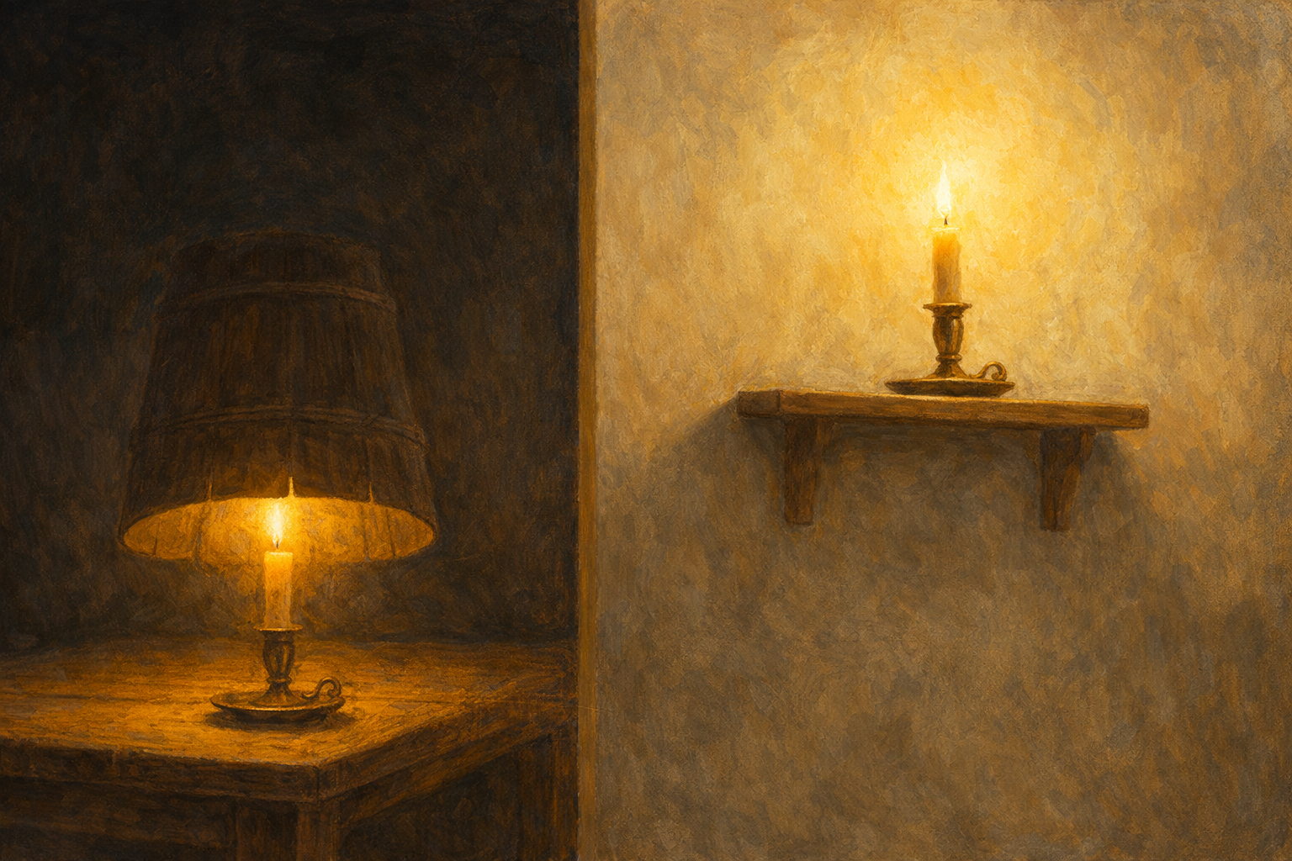
Casting a Shadow: Where the Shadow Falls
Matthew 5:14 Ye are the light of the world. A city that is set on an hill cannot be hid.
Matthew 5:15 Neither do men light a candle, and put it under a bushel, but on a candlestick; and it giveth light unto all that are in the house.

Slide 14
The Shadow We Cast: Stephen
An Example of a Consecrated Heart that Stood Out from the Crowd

Slide 15
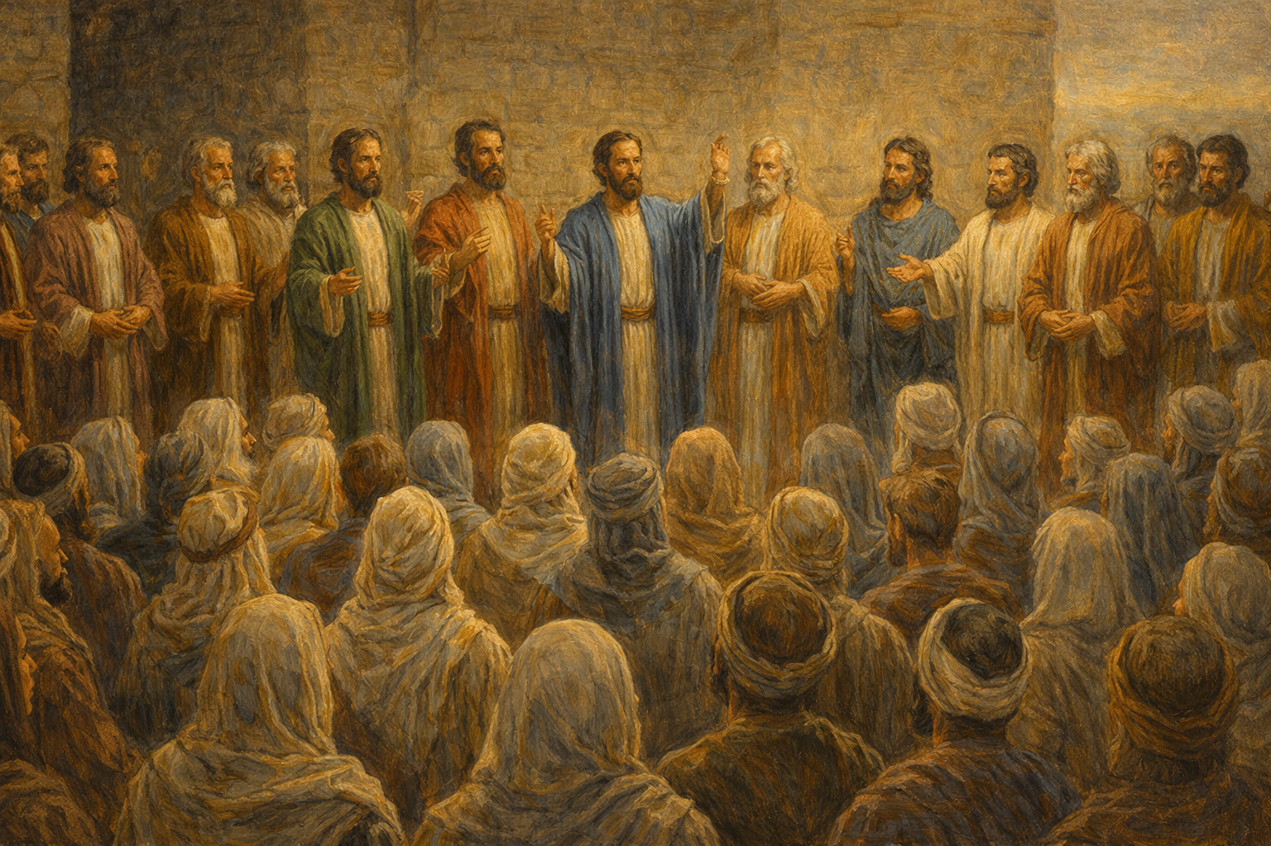
Acts 6:1 And in those days, when the number of the disciples was multiplied, there arose a murmuring of the Grecians against the Hebrews, because their widows were neglected in the daily ministration.
Acts 6:3 Wherefore, brethren, look ye out among you seven men of honest report, full of the Holy Ghost and wisdom, whom we may appoint over this business.

Slide 16
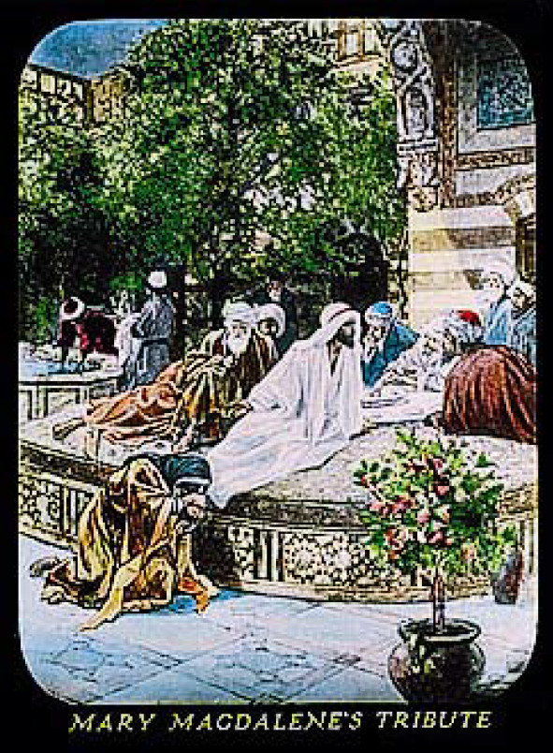
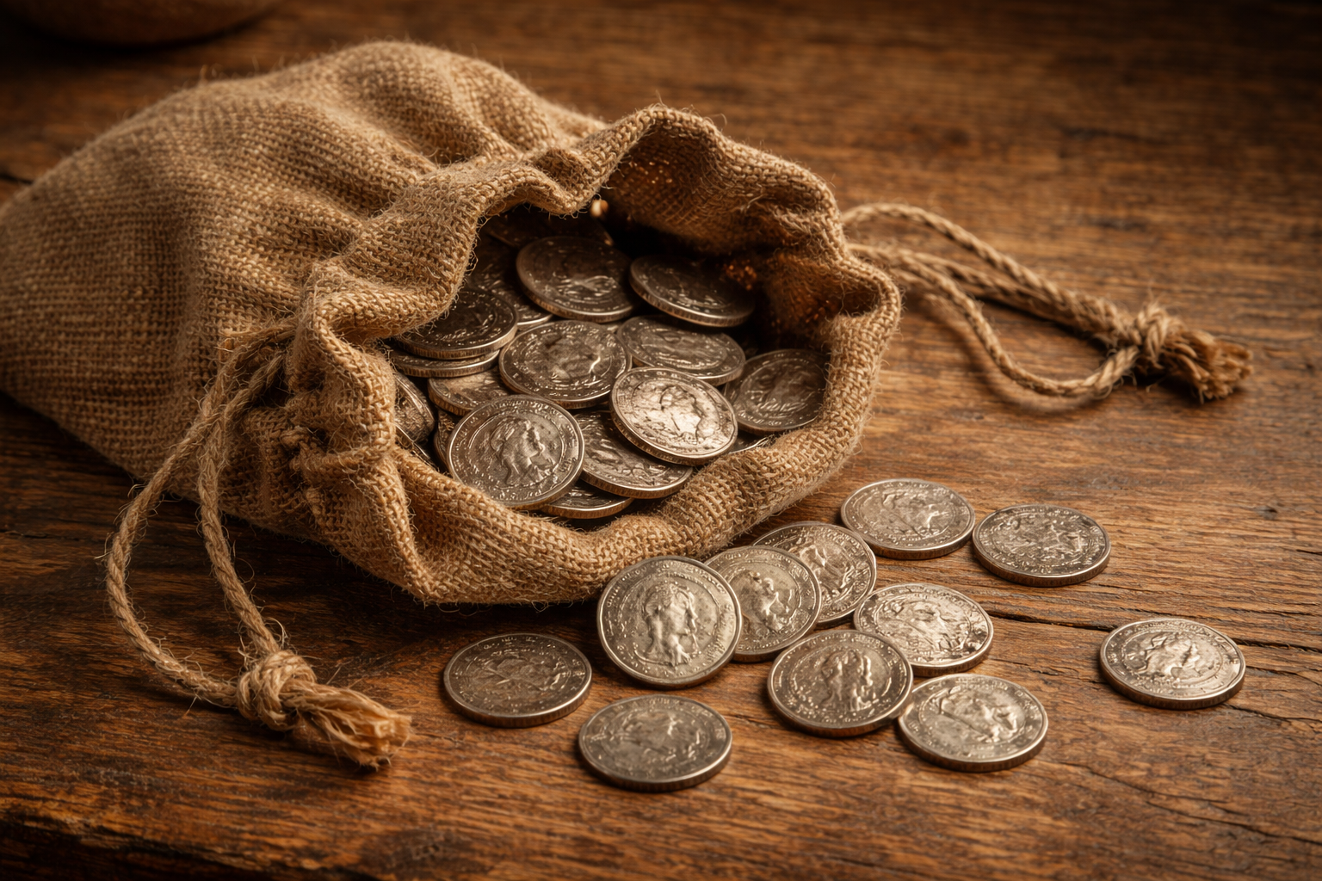
Character Trait 1: Of good report
John 12:4 Then saith one of his disciples, Judas Iscariot, Simon's son, which should betray him 12:5 Why was not this ointment sold for three hundred pence, and given to the poor? 12:6 This he said, not that he cared for the poor; but because he was a thief, and had the bag, and bare what was put therein.
Accustomed to voluntary giving to the Levites, the Jews evidently extended this usage to everything religious that appealed to them as being of God. The disciples had a general treasurer, Judas (John 12:6; 13:29), and evidently never lacked; though it is equally evident that they never solicited alms. – Volume 6, p 186

Slide 17
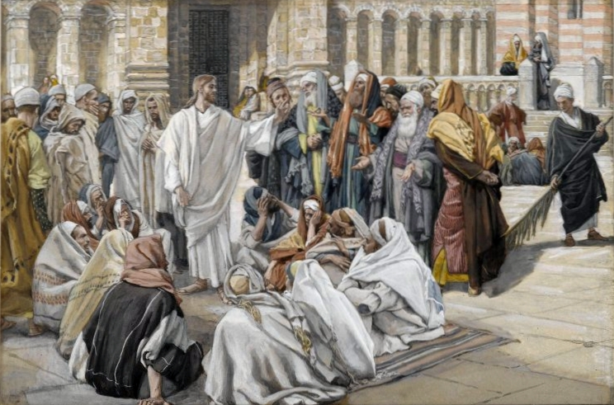
Character Trait 2: Full of the Spirit
Matthew 23:2 Saying The scribes and the Pharisees sit in Moses' seat: 23:3 All therefore whatsoever they bid you observe, that observe and do; but do not ye after their works: for they say, and do not. 23:4 For they bind heavy burdens and grievous to be borne, and lay them on men's shoulders; but they themselves will not move them with one of their fingers. 23:5 But all their works they do for to be seen of men: they make broad their phylacteries, and enlarge the borders of their garments,

Slide 18
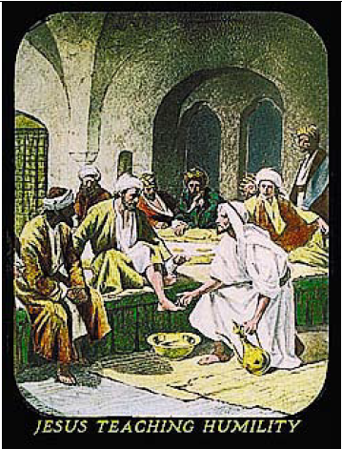
Character Trait 2: Full of the Spirit
John 13:3 Jesus knowing that the Father had given all things into his hands, and that he was come from God, and went to God; 13:4 He riseth from supper, and laid aside his garments; and took a towel, and girded himself. 13:5 After that he poureth water into a bason, and began to wash the disciples' feet, and to wipe them with the towel wherewith he was girded.
Acts 2:1 And when the day of Pentecost ¹⁵was now come, they were all together in one place. 2:2 And suddenly there came from heaven a sound as of the rushing of a mighty wind, and it filled all the house where they were sitting. 2:3 And there appeared unto them tongues ¹⁶parting among them, like as of fire; and it sat upon each one of them. 2:4 And they were all filled with the Holy Spirit, and began to speak with other tongues, as the Spirit gave them utterance.

Slide 19
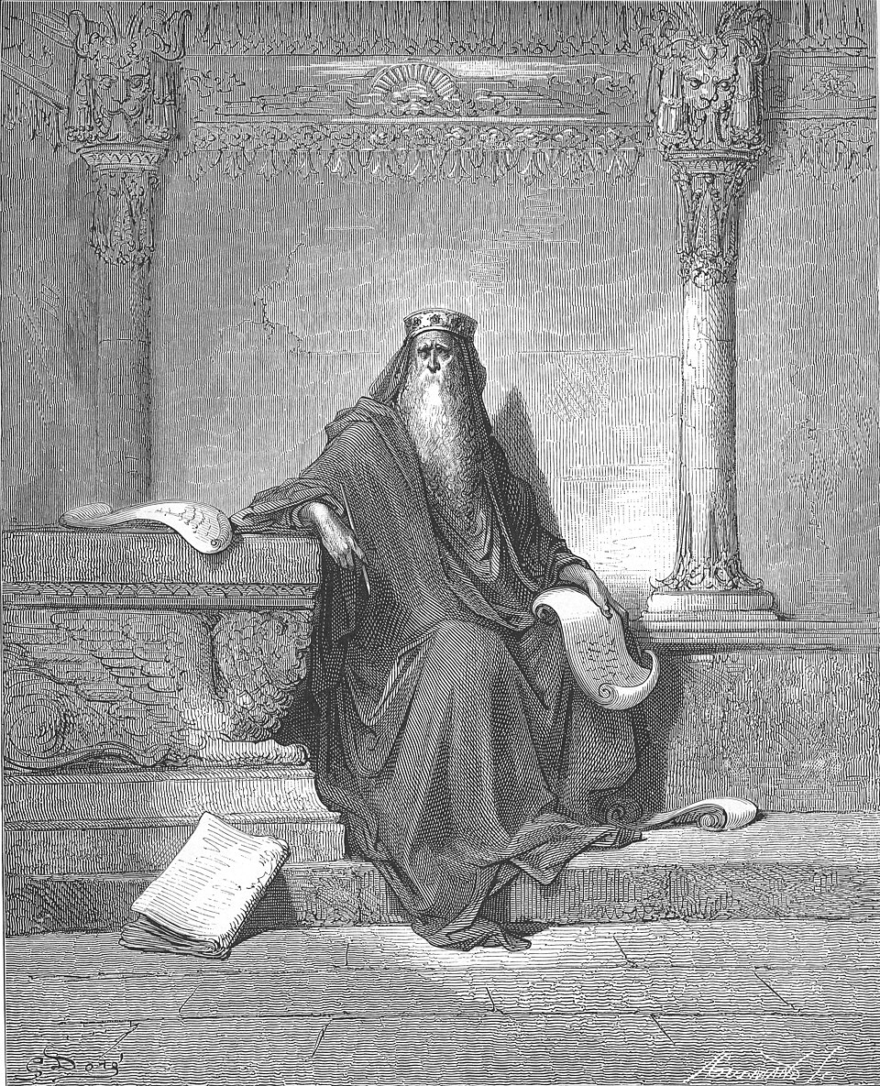
Character Trait 3: Of wisdom
1 Kings 3:9 Give therefore thy servant an understanding heart to judge thy people, that I may discern between good and bad: for who is able to judge this thy so great a people? 1 Kings 3:10 And the speech pleased the LORD, that Solomon had asked this thing.

Slide 20
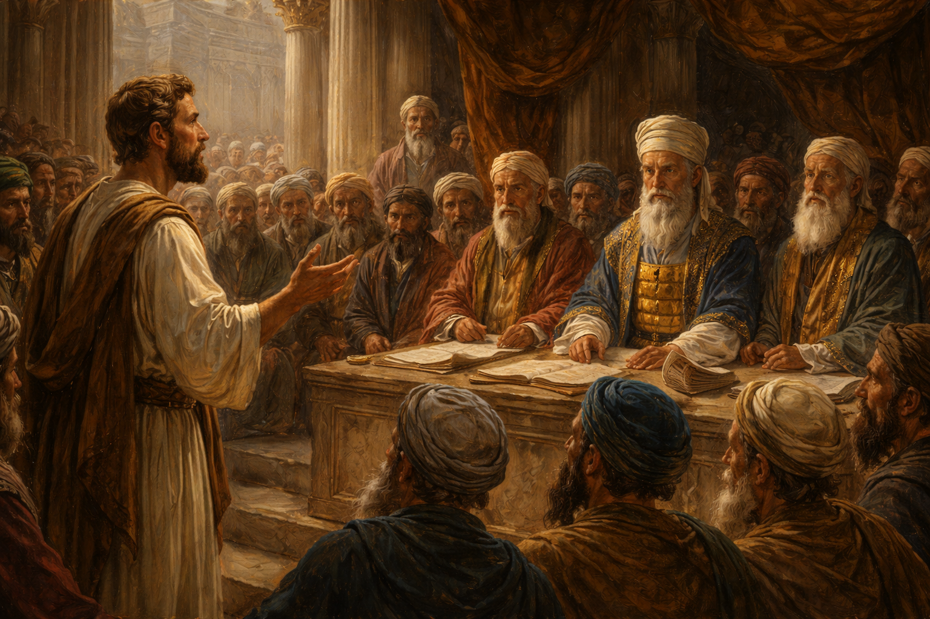
Character Trait 3: Of wisdom
Acts 6:5 And the saying pleased the whole multitude: and they chose Stephen, a man full of faith and of the Holy Ghost, and Philip, and Prochorus, and Nicanor, and Timon, and Parmenas, and Nicolas a proselyte of Antioch:
Acts 6:8 And Stephen, full of faith and power, did great wonders and miracles among the people.
Acts 6:10 And they were not able to resist the wisdom and the spirit by which he spake.

Slide 21
The Shadow We Cast: Paul
An Example for the Church

Slide 22
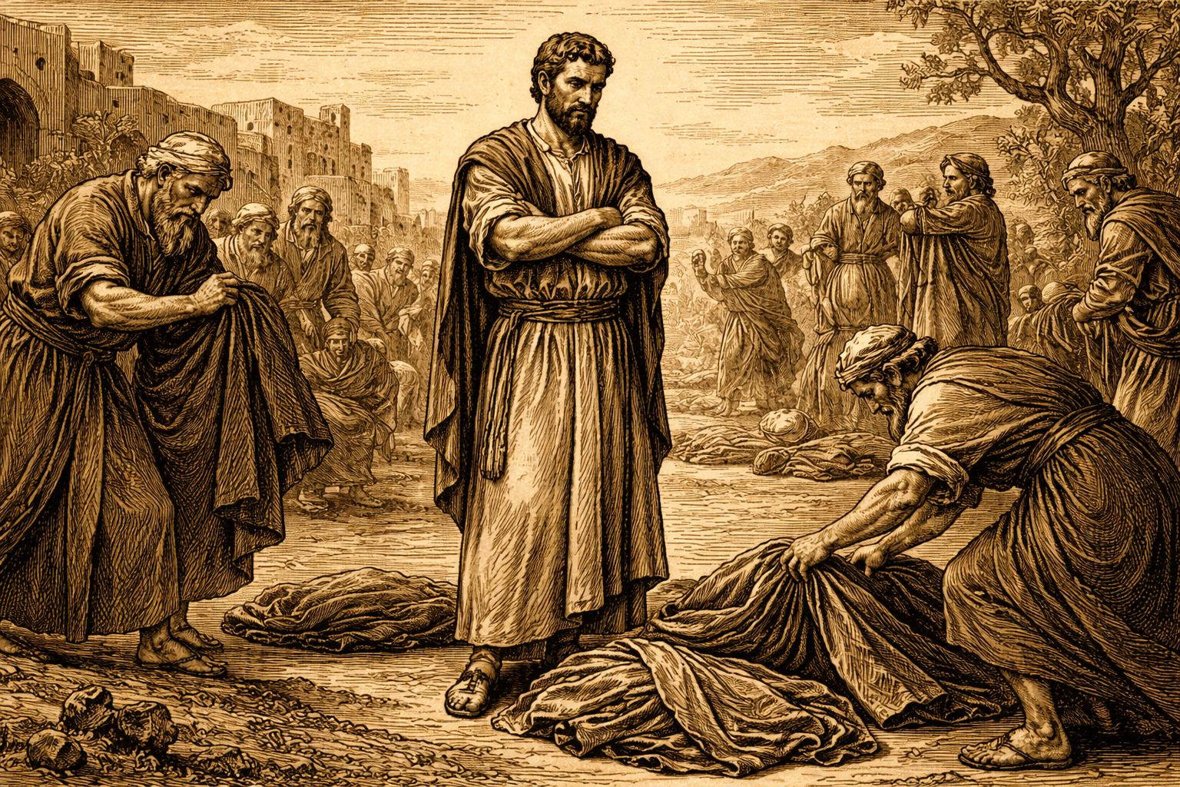
Acts 8:3 As for Saul, he made havock of the church, entering into every house, and haling men and women committed them to prison.
Acts 7:58 And cast him out of the city, and stoned him: and the witnesses laid down their clothes at a young man's feet, whose name was Saul.

Slide 23
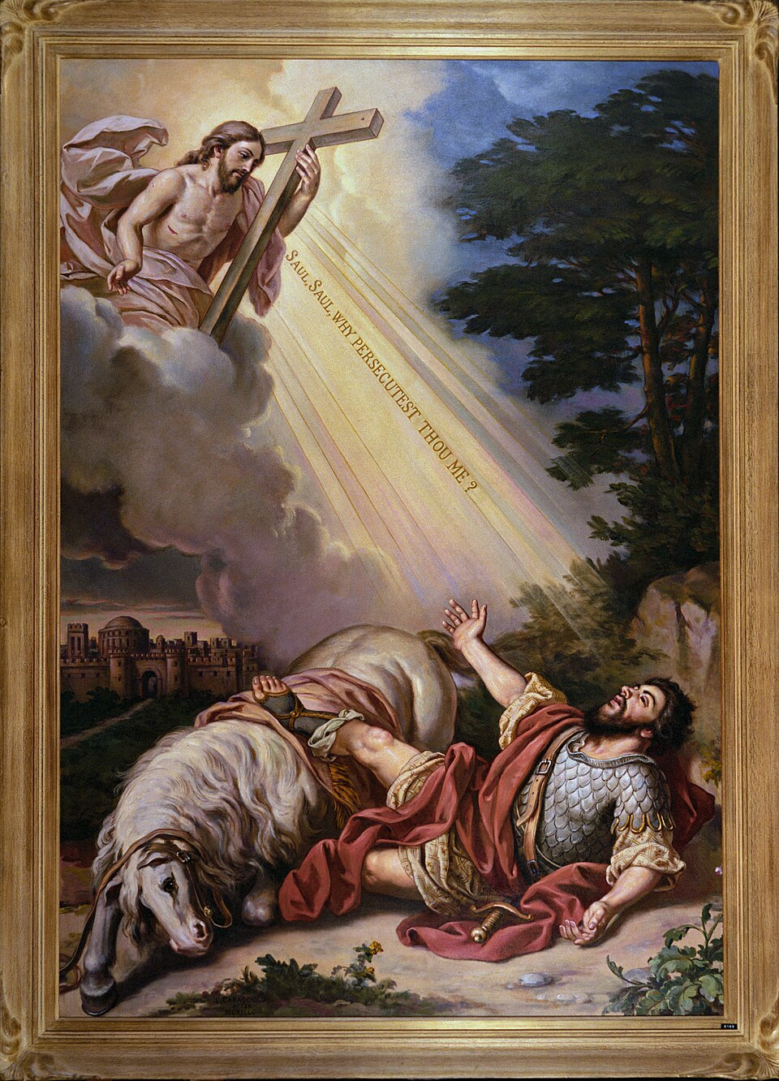
Acts 9:3 And as he journeyed, he came near Damascus: and suddenly there shined round about him a light from heaven: 9:4 And he fell to the earth, and heard a voice saying unto him, Saul, Saul, why persecutest thou me? 9:5 And he said, Who art thou, Lord? And the Lord said, I am Jesus whom thou persecutest: it is hard for thee to kick against the pricks.

Slide 24
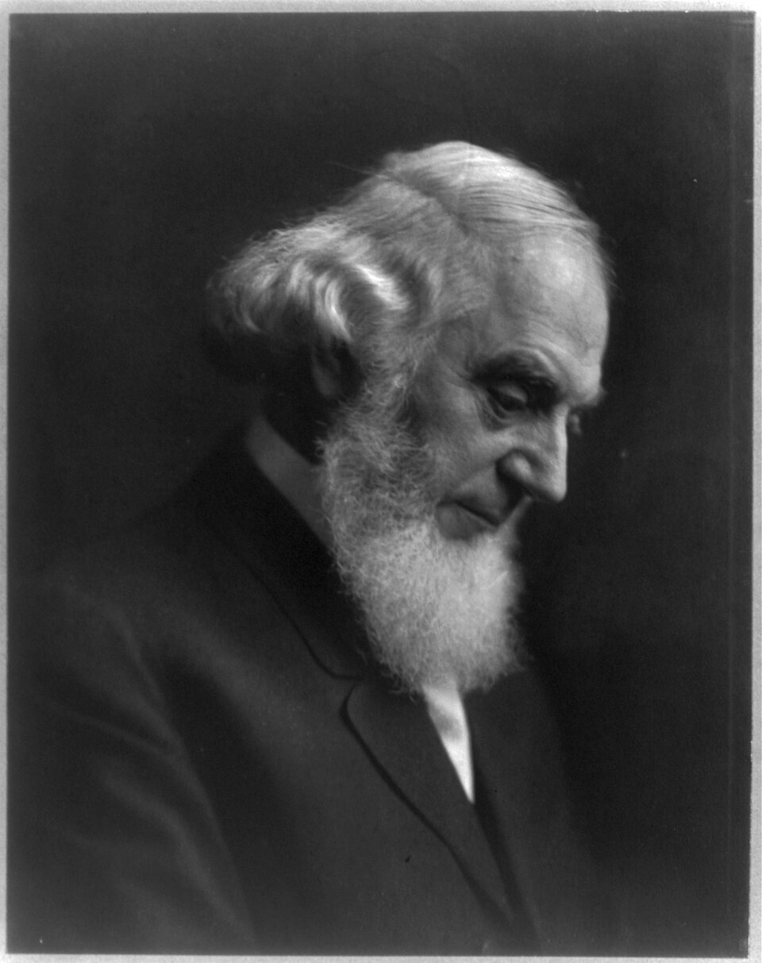
Revelation 21:14 And the wall of the city had twelve foundations, and in them the names of the twelve apostles of the Lamb.
There is one other thought suggested by the above words of the Apostle which we would do well to consider, and that is, that as his faithful and successful course was a worthy and safe example to the Church, so likewise should each disciple of Christ in turn consider that his example will have its influence upon others.
Every Christian should strive to be a pattern worthy of imitation – a pattern of earnest, faithful endeavor to copy Christ in his daily life, and of active zeal in his service. Patterns of perfection, of the ultimate moral glory and beauty of holiness, we cannot expect to be in the present life. Such a pattern we have only in Christ our Lord. In no such sense did Paul ever say, Follow me, or Follow us; but he did say, "Be ye followers of me, even as I also am of Christ." – 1 Cor. 11:1.

Slide 25
The Apostle was a grand example of earnest endeavor to attain perfection, but not of the ultimate perfection which was in Christ only; and it is his zeal and intense earnestness in striving to copy Christ and to accomplish his will that we should imitate. Let us mark all such worthy examples while we also "press toward the mark [of character] for [the attainment of] the prize of our high calling." – R1886

Slide 26
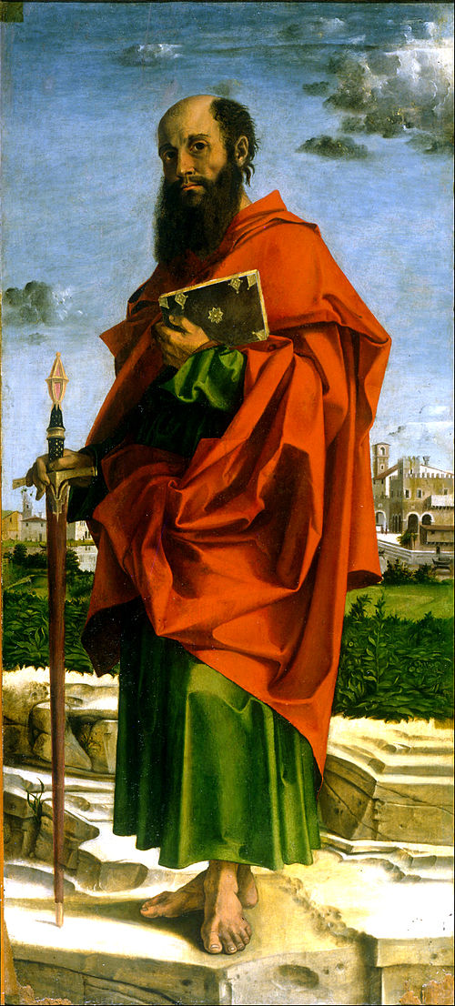
First: The Apostle made a humble sober estimate of his spiritual standing and strength.
Philippians 4:13 I can do all things through Christ which strengtheneth me.
Romans 12:1 I beseech you therefore, brethren, by the mercies of God, that ye present your bodies a living sacrifice, holy, acceptable unto God, which is your reasonable service.
Acts 20:19 Serving the LORD with all humility of mind, and with many tears, and temptations, which befell me by the lying in wait of the Jews

Slide 27
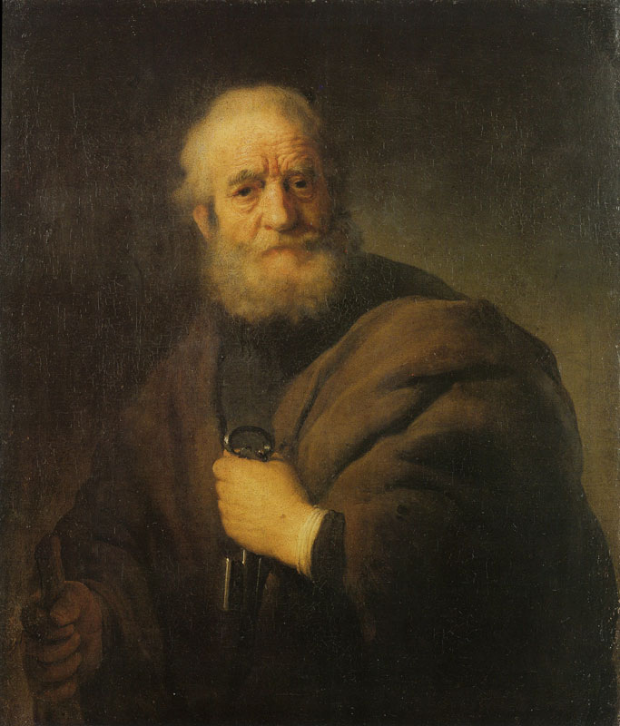
Second: We observe the Apostle’s singleness of purpose – “This one thing I do.” He did not try to do several things: if he had, he would surely have failed.
Philippians 3:13 Brethren, I count not myself to have apprehended: but this one thing I do, forgetting those things which are behind, and reaching forth unto those things which are before, 3:14 I press toward the mark for the prize of the high calling of God in Christ Jesus.

Slide 28
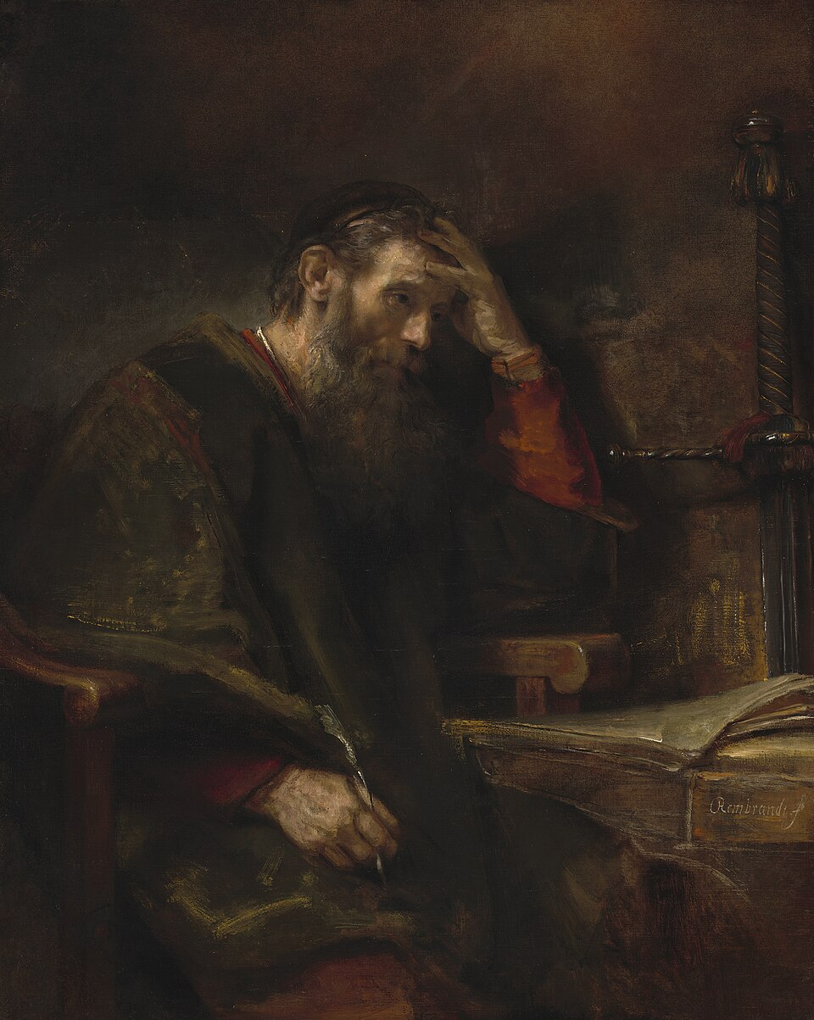
Third: We observe that he determined to forget the things behind.
Acts 8:3 As for Saul, he made havock of the church, entering into every house, and haling men and women committed them to prison.
1 Cornithians 15:9 For I am the least of the apostles, that am not meet to be called an apostle, because I persecuted the church of God. 15:10 But by the grace of God I am what I am: and his grace which was bestowed upon me was not in vain; but I laboured more abundantly than they all: yet not I, but the grace of God which was with me.
Acts 9:1 And Saul, yet breathing out threatenings and slaughter against the disciples of the Lord, went unto the high priest

Slide 29
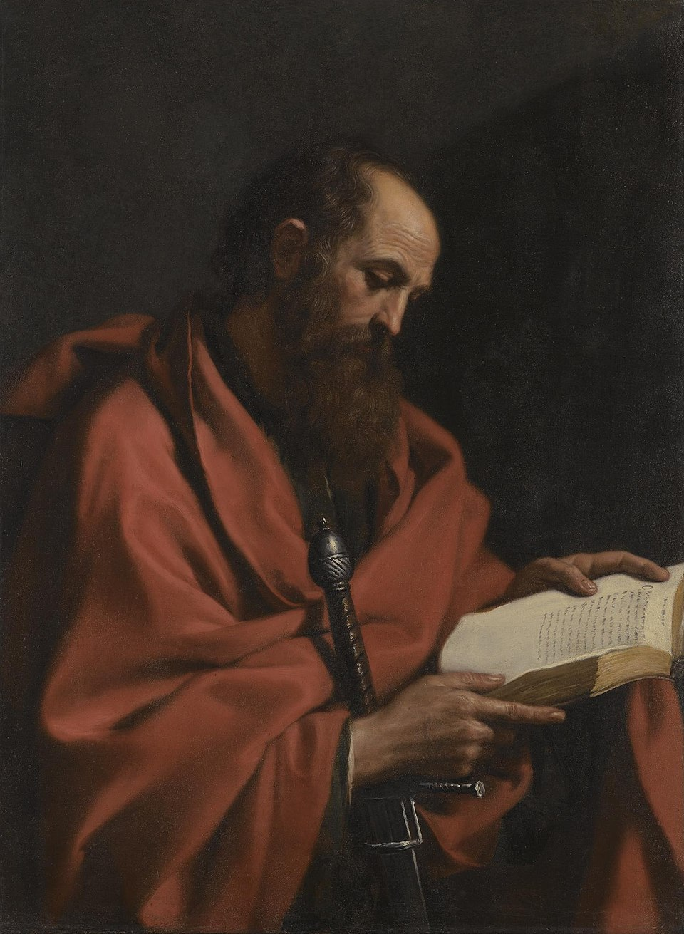
Fourth: He reached forward to the things that were before, - his faith took hold of the promises of God with such tenacity that to him they were living realities, inspiring zeal and faithfulness.
Philippians 4:8 Finally, brethren, whatsoever things are true, whatsoever things are honest, whatsoever things are just, whatsoever things are pure, whatsoever things are lovely, whatsoever things are of good report; if there be any virtue, and if there be any praise, think on these things.
Hebrews 11:1 Now faith is the substance of things hoped for, the evidence of things not seen.

Slide 30
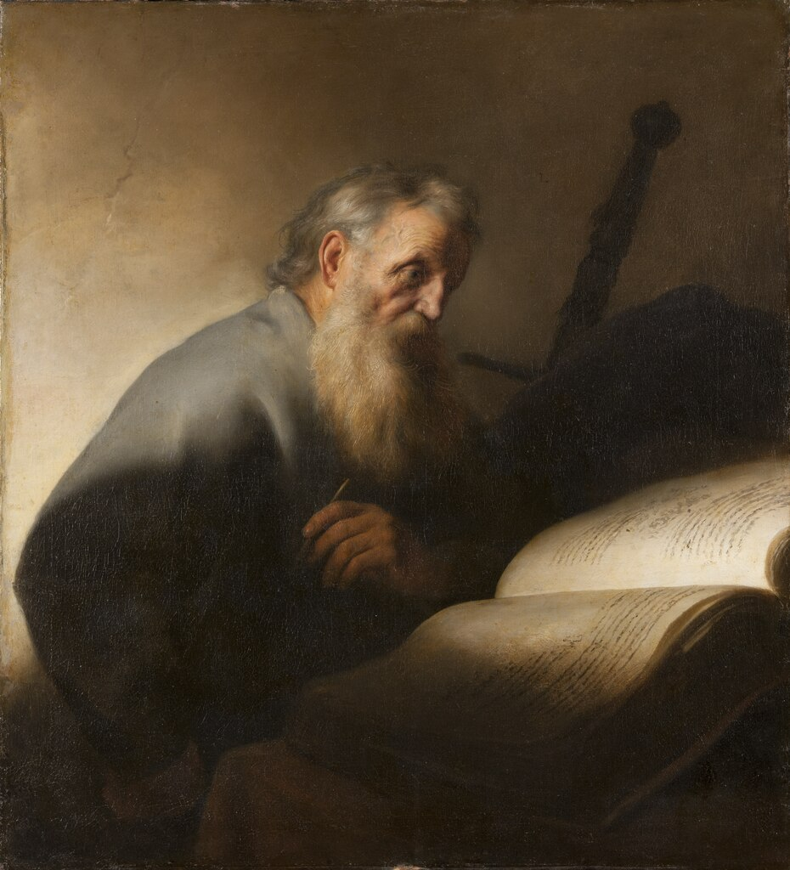
Fifth: We note the Apostle’s energetic zeal, which not only reached forward in contemplation of and desire for the beauty of holiness and the heavenly glory, but also earnestly pressed toward the mark for the prize.
Hebrews 12:1 Wherefore seeing we also are compassed about with so great a cloud of witnesses, let us lay aside every weight, and the sin which doth so easily beset us, and let us run with patience the race that is set before us,

Slide 31
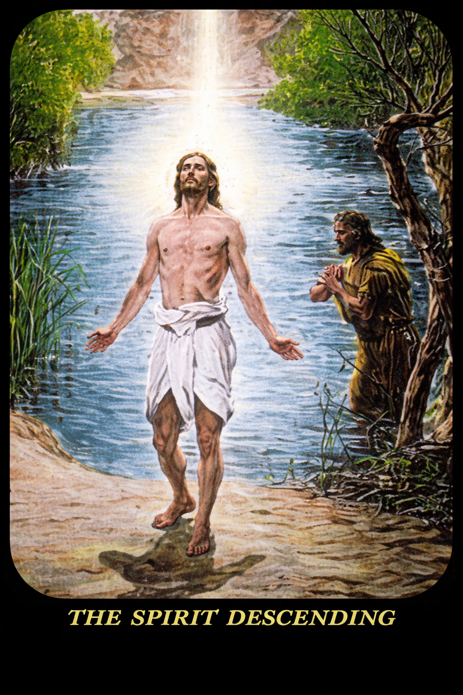
The structure of the New Testament is a remarkable assurance to the Church that, “Yes, we can!”
An imperfect body, made perfect and acceptable through the merit of the head
A perfect head

Slide 32
In Summary: The Shadow We Cast

Slide 33
1 Peter 2:9 But ye are a chosen generation, a royal priesthood, an holy nation, a peculiar people; that ye should shew forth the praises of him who hath called you out of darkness into his marvellous light

Slide 34
Image Credits
All images used in this presentation were created by ChatGpt based on prompts written by the author, or taken from Photo-Drama of the Creation, or are public domain images via commons.wikimedia.
Background image: Standing in the Light - Image generated using ChatGPT (OpenAI) based on a prompt written by David Larson.
Slide 4: Gravestone: Image generated using ChatGPT (OpenAI) based on a prompt written by David Larson.
Slide 5: Shepherd - Image generated using ChatGPT (OpenAI) based on a prompt written by David Larson.
Slide 6: Shadow Diagram - Image generated using ChatGPT (OpenAI) based on a prompt written by David Larson.
Slide 7 - Polar Mesospheric Clouds Illuminated by Orbital Sunrise, NASA Earth Observatory via commons.wikimedia.org (Public Domain)
Slide 8: The sun rises above the Pacific Ocean, NASA Johnson Space Center via commons.wikimedia.org (Public Domain)
Slide 9 and 30: The Spirit Descending – From Photo-Drama of the Creation
Slide 10: Children playing - Image generated using ChatGPT (OpenAI) based on a prompt written by David Larson.

Slide 35
Image Credits (continued)
Slide 10: Expulsion from Eden – from Photo-Drama of the Creation
Slide 11: Cemetery via commons.wikimedia.org (Public Domain)
Slide 11: Thou art the Christ – from Photo-Drama of Creation
Slide 12: The Rock of Cashel by Matpib via commons.wikimedia.org (Public Domain)
Slide 13: Light under a bushel - Image generated using ChatGPT (OpenAI) based on a prompt written by David Larson.
Slide 15: Commissioning the Deacons - Image generated using ChatGPT (OpenAI) based on a prompt written by David Larson.
Slide 16: Donation bag - Image generated using ChatGPT (OpenAI) based on a prompt written by David Larson.
Slide 16: Mary Magdelene’s Tribute from Ph
Slide 17: The Pharisees Question Jesus by James Tissot via commons.wikimedia.org (Public Domain)
Slide 18: Jesus teaching humility from Photo-Drama of Creation
Slide 19: King Solomon in Old Age by Gustave Dore via commons.wikimedia.org (Public Domain)
Slide 20: Stephen addressing the council - Image generated using ChatGPT (OpenAI) based on a prompt written by David Larson.
Slide 22: Saul from Act 7:58 - Image generated using ChatGPT (OpenAI) based on a prompt written by David Larson.
Slide 23: Conversion of Paul by Caracciolo via commons.wikimedia.org (Public Domain)
Slide 24 and 25: Charles Taize Russell, Library of Congress via commons.wikimedia.org (Public Domain)

Slide 36
Image Credits (continued)
Slide 26: Saint Paul by Bartolomeo Montagna via commons.wikimedia.org (Public Domain)
Slide 27: The Apostle Paul by Rembrandt via commons.wikimedia.org (Public Domain)
Slide 28: Apostle Paul by Rembrandt van Rijn via commons.wikimedia.org (Public Domain)
Slide 29 and 31: Saint Paul by Guercino via commons.wikimedia.org (Public Domain)
Slide 30: Apostle Paul by Jan Lievens via commons.wikimedia.org (Public Domain)

Slide 37
BACKUP SLIDES

Slide 38
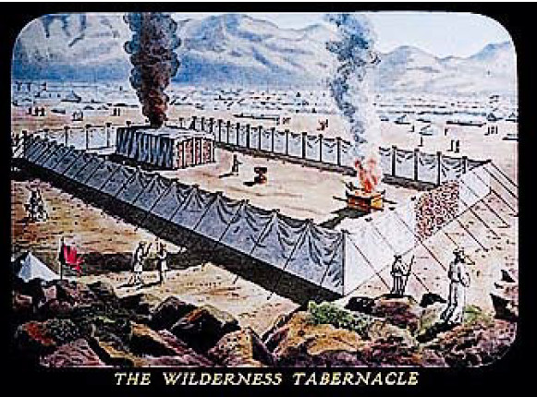
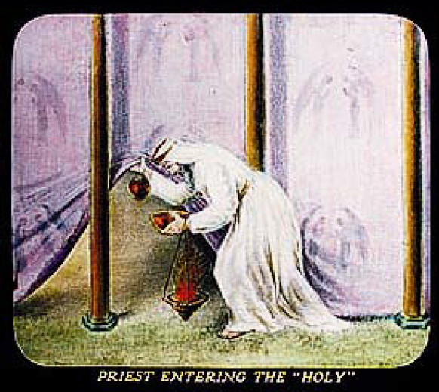

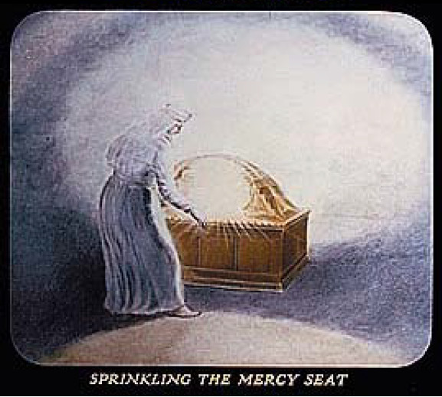
Using “shadow” in our fellowship

