Slide 1
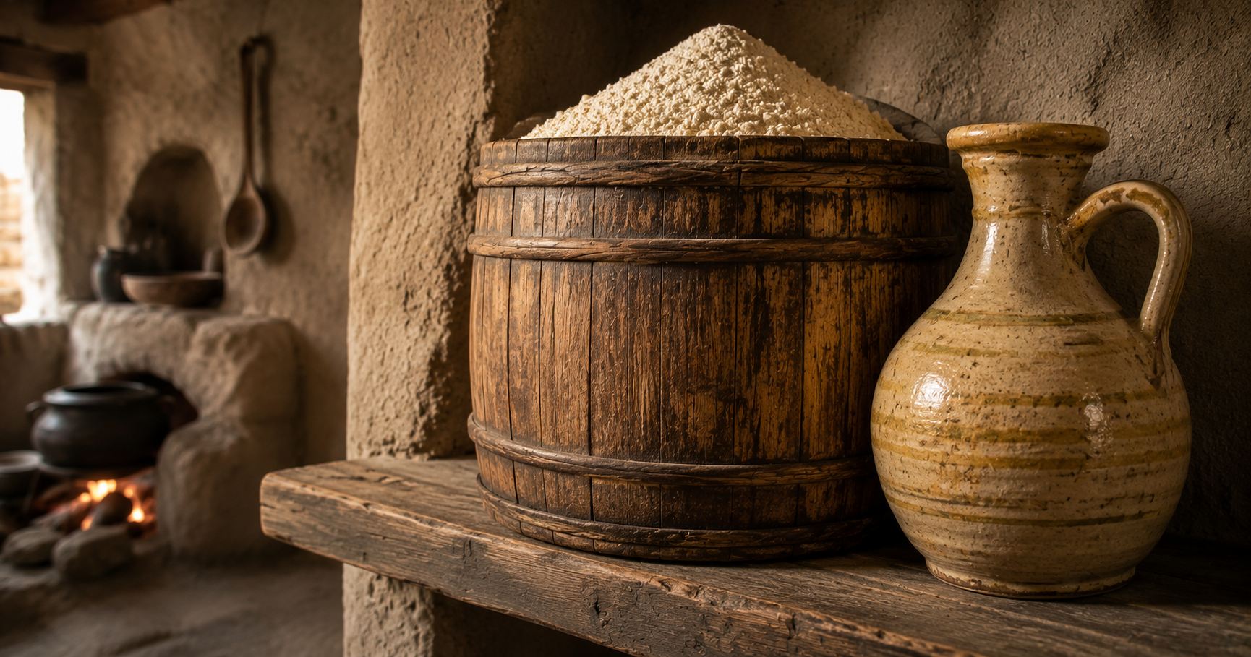
Three People, Two Ingredients, One Faith
Reflections on 1 Kings 17

Slide 2


Slide 3
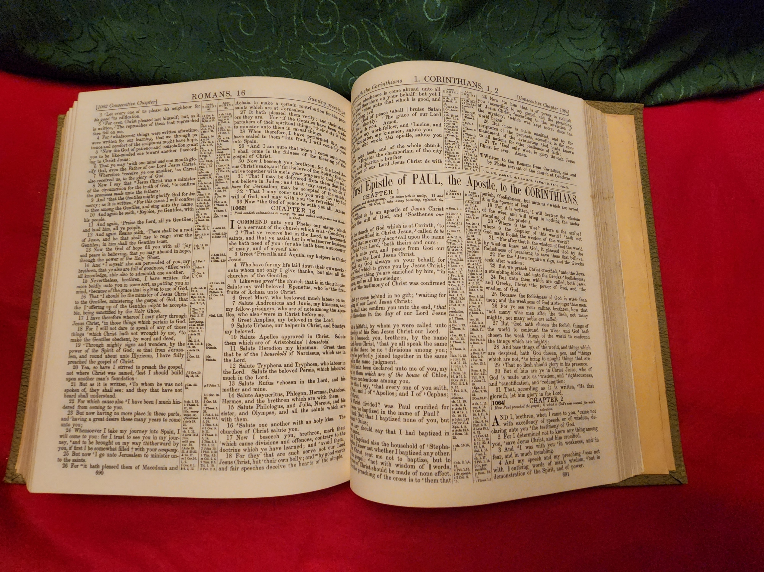
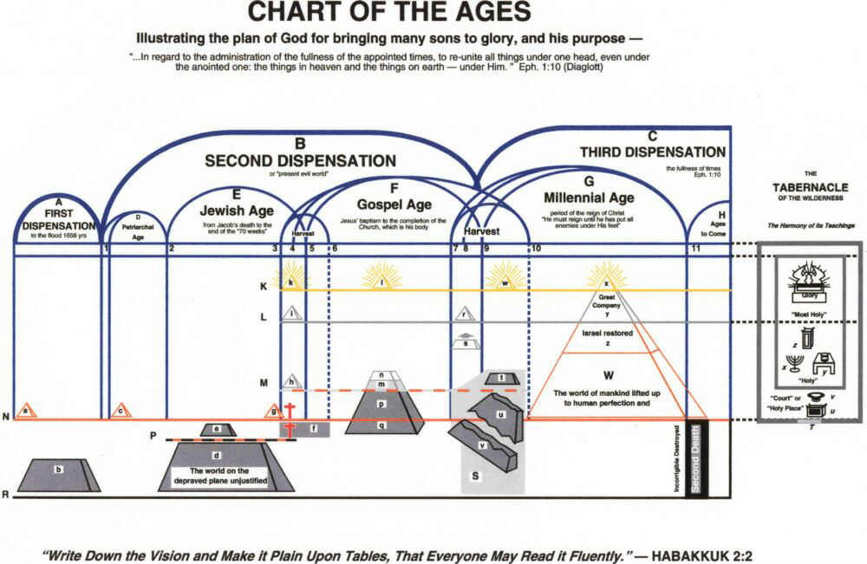

Slide 4
A Summary of 1 Kings 17

Slide 5
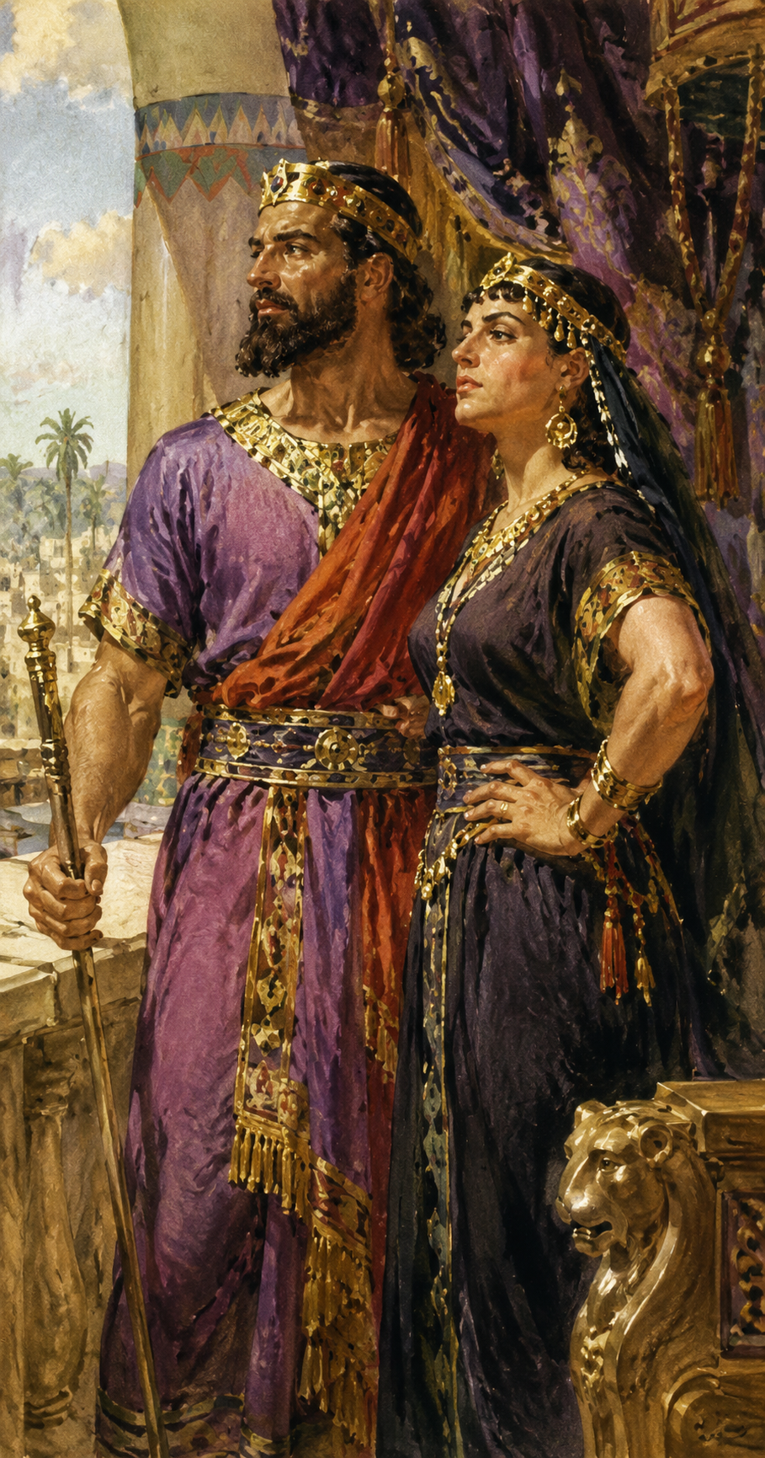
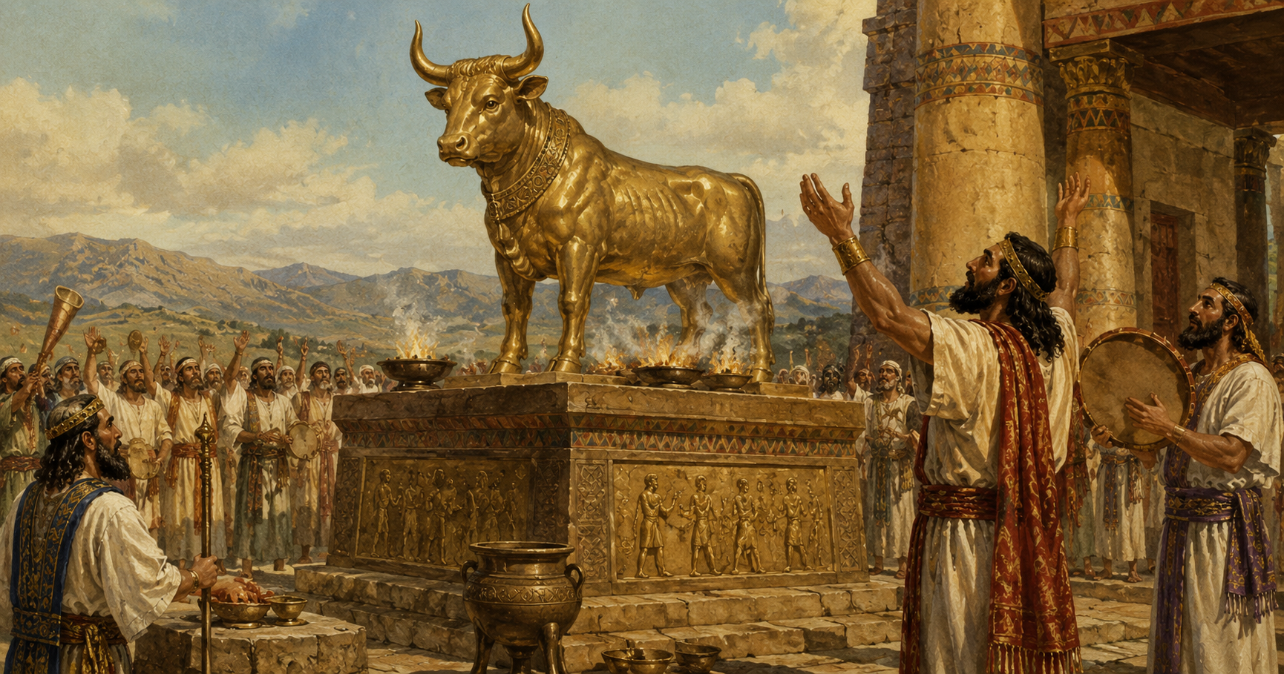
1 Kings 16:33 And Ahab made a grove; and Ahab did more to provoke the LORD God of Israel to anger than all the kings of Israel that were before him.

Slide 6
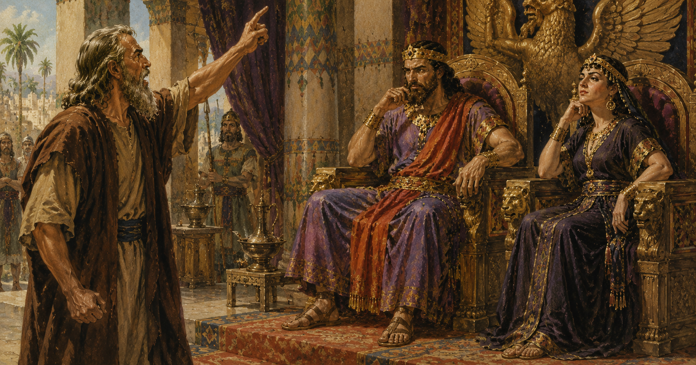
1 Kings 17:1 And Elijah the Tishbite, who was of the inhabitants of Gilead, said unto Ahab, As the LORD God of Israel liveth, before whom I stand, there shall not be dew nor rain these years, but according to my word.

Slide 7
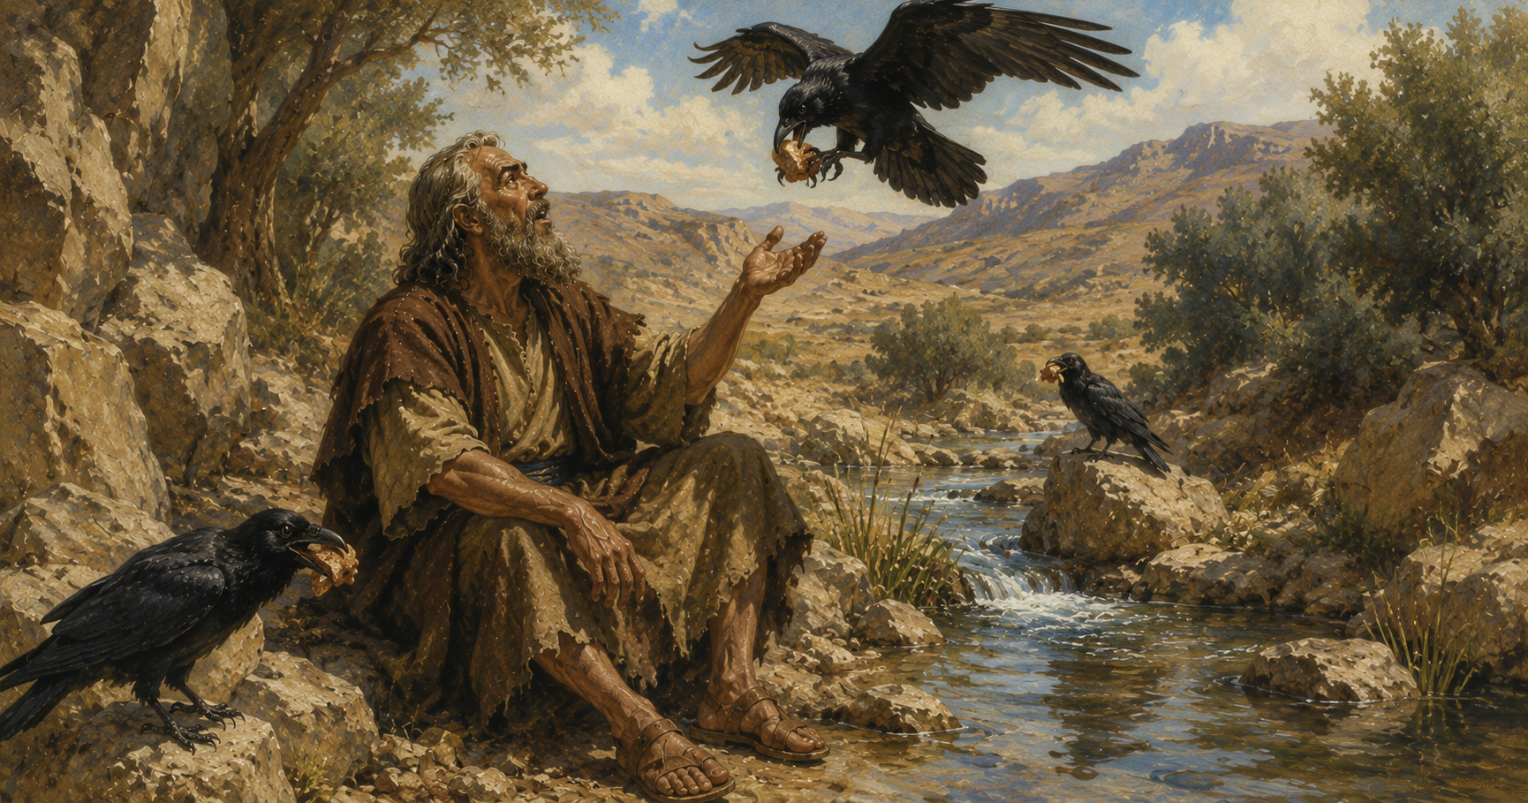
1 Kings 17:2 And the word of the LORD came unto him, saying,
17:3 Get thee hence, and turn thee eastward, and hide thyself by the brook Cherith, that is before Jordan.
1 Kings 17:4 And it shall be, that thou shalt drink of the brook; and I have commanded the ravens to feed thee there.

Slide 8
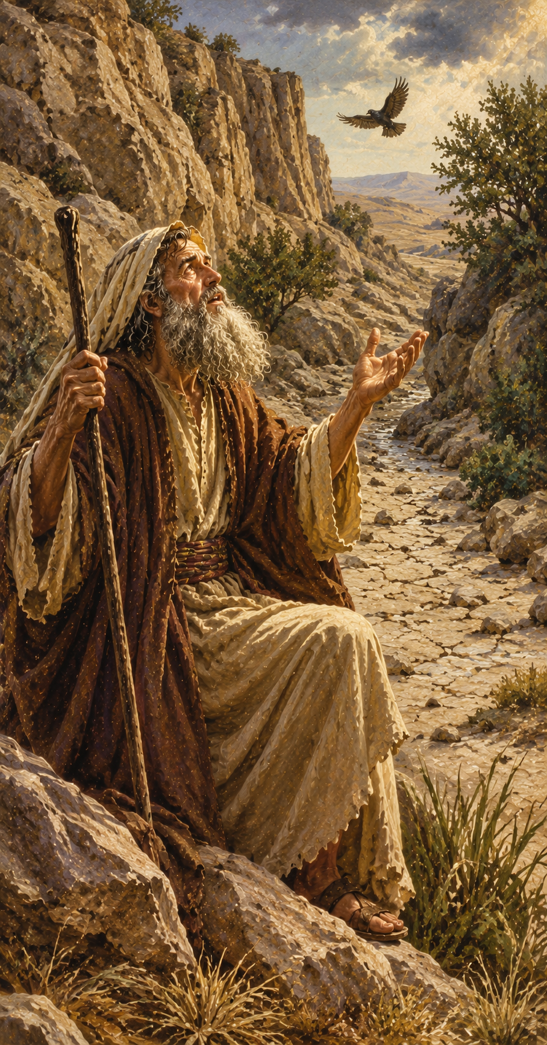
1 Kings 17:8 And the word of the LORD came unto him, saying,
17:9 Arise, get thee to Zarephath, which belongeth to Zidon, and dwell there: behold, I have commanded a widow woman there to sustain thee.
1 Kings 17:7 And it came to pass after a while, that the brook dried up, because there had been no rain in the land.

Slide 9
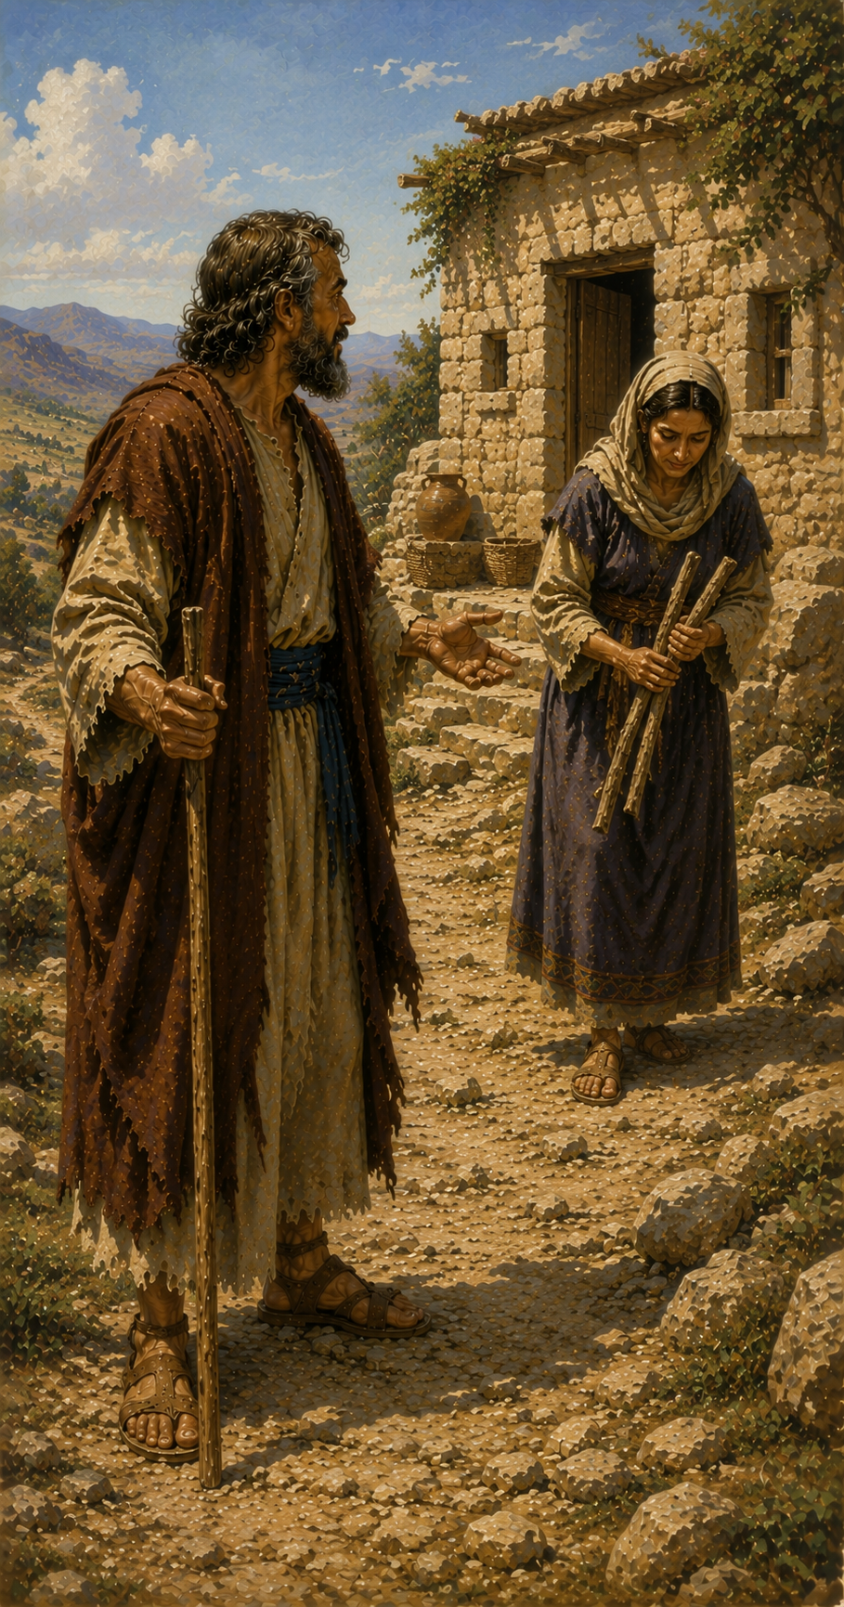
1 Kings 17:10 So he arose and went to Zarephath. And when he came to the gate of the city, behold, the widow woman was there gathering of sticks: and he called to her, and said, Fetch me, I pray thee, a little water in a vessel, that I may drink.
1 Kings 17:12 And she said, As the LORD thy God liveth, I have not a cake, but an handful of meal in a barrel, and a little oil in a cruse: and, behold, I am gathering two sticks, that I may go in and dress it for me and my son, that we may eat it, and die.
1 Kings 17:11 And as she was going to fetch it, he called to her, and said, Bring me, I pray thee, a morsel of bread in thine hand.

Slide 10
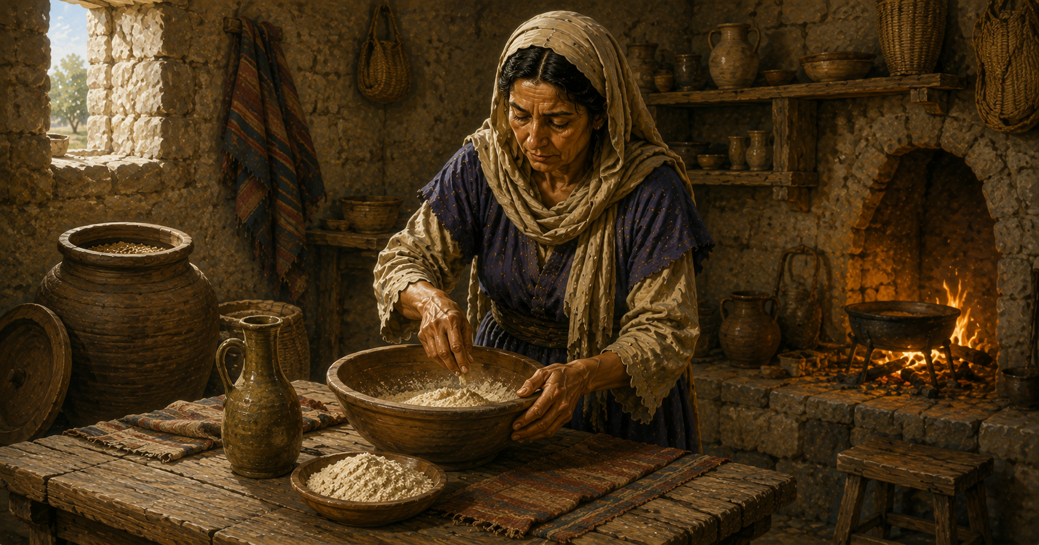
1 Kings 17:13 And Elijah said unto her, Fear not; go and do as thou hast said: but make me thereof a little cake first, and bring it unto me, and after make for thee and for thy son.
1 Kings 17:14 For thus saith the LORD God of Israel, The barrel of meal shall not waste, neither shall the cruse of oil fail, until the day that the LORD sendeth rain upon the earth.

Slide 11
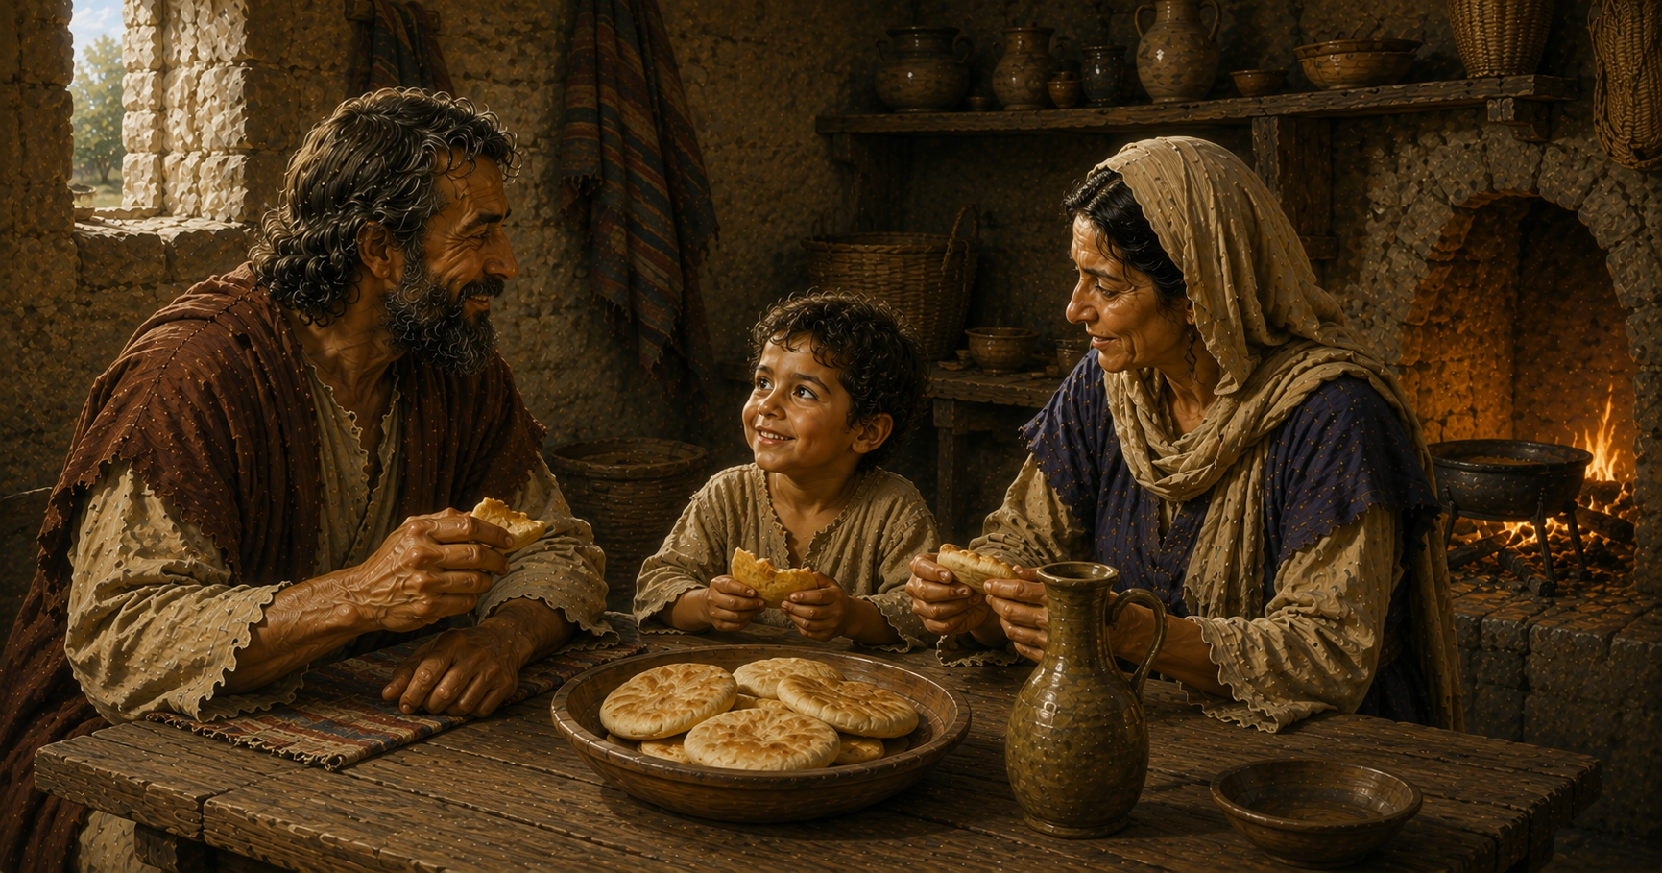
1 Kings 17:15 And she went and did according to the saying of Elijah: and she, and he, and her house, did eat many days.
1 Kings 17:16 And the barrel of meal wasted not, neither did the cruse of oil fail, according to the word of the LORD, which he spake by Elijah.

Slide 12
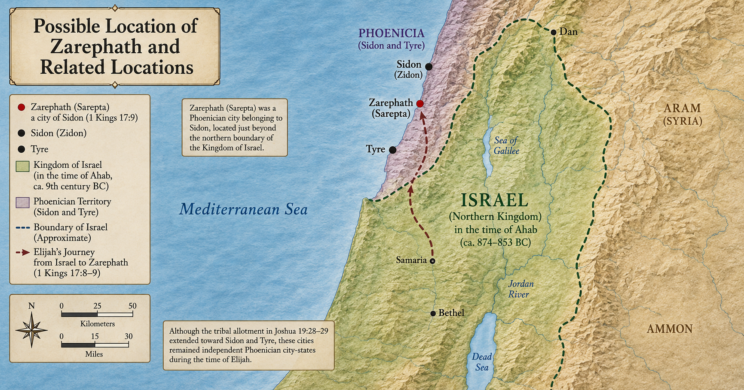

Slide 13
Part 1: The Widow
Let no man take your crown.
Sometimes, God requires faith before deliverance.
Part 2: The Meal and the Oil
It requires faith to understand that God has provided what we need to make our calling and election sure.
We need to combine our spiritual ingredients to produce something acceptable to our calling.
Part 3: Elijah
God will deliver us, but we need to recognize and accept His deliverance when it comes.
God will deliver us, but deliverance isn’t always a passive experience.

Slide 14

The Widow of Zarephath (1 Kings 17)
Verse 9: Arise, get thee to Zarephath… I have commanded a widow woman there to sustain thee.
Verse 10: … the widow woman was there gathering of sticks…
Verse 17: … the son of the woman, the mistress of the house, fell sick
Verse 23: And Elijah took the child… and delivered him unto his mother…
Verse 24: And the woman said to Elijah…

Slide 15
Part 1: The Widow
Let no man take your crown.
Sometimes, God requires faith before deliverance.
Part 2: The Meal and the Oil
It requires faith to understand that God has provided what we need to make our calling and election sure.
We need to combine our spiritual ingredients to produce something acceptable to our calling.
Part 3: Elijah
God will deliver us, but we need to recognize and accept His deliverance when it comes.
God will deliver us, but deliverance isn’t always a passive experience.

Slide 16
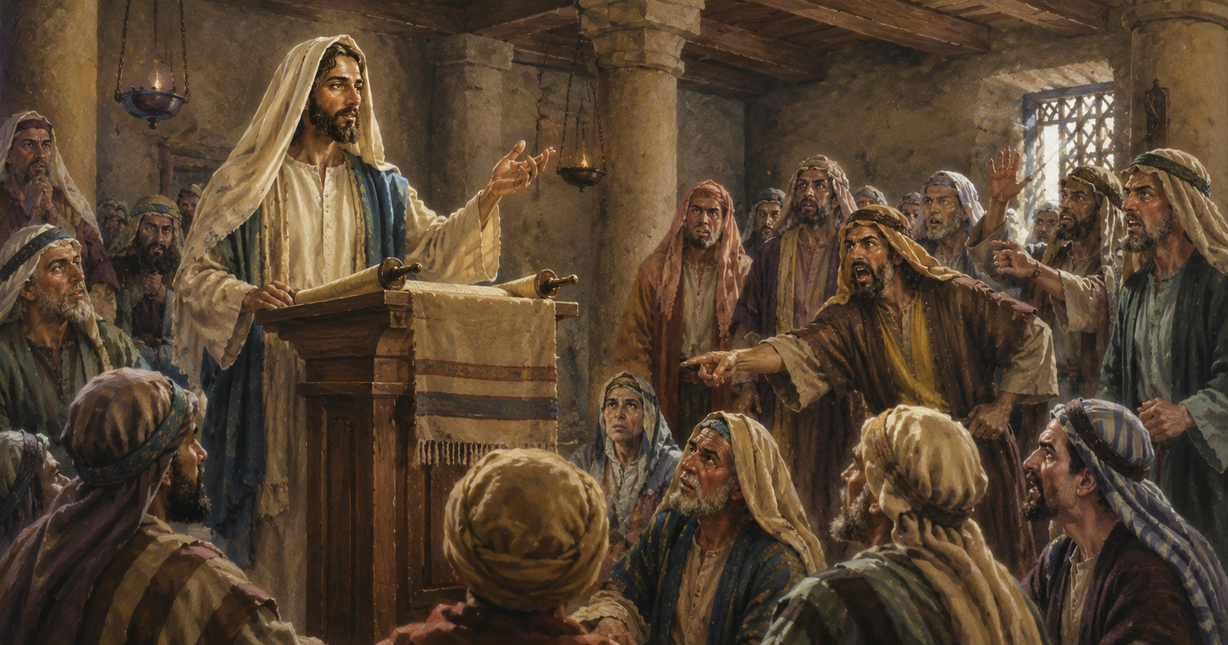
Lesson 1: Let no man take your crown.
Luke 4:25 But I tell you of a truth, many widows were in Israel in the days of Elias, when the heaven was shut up three years and six months, when great famine was throughout all the land;
Luke 4:26 But unto none of them was Elias sent, save unto Sarepta, a city of Sidon, unto a woman that was a widow.

Slide 17
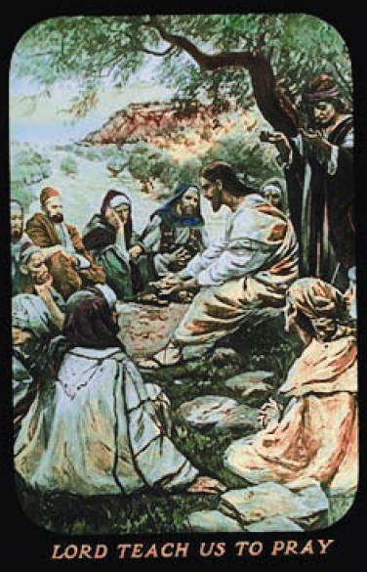
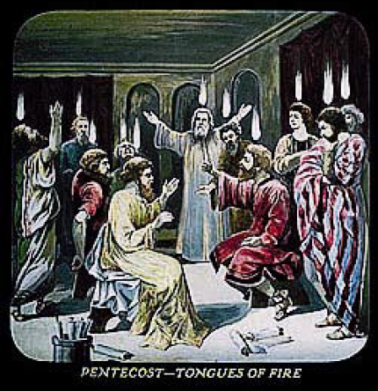
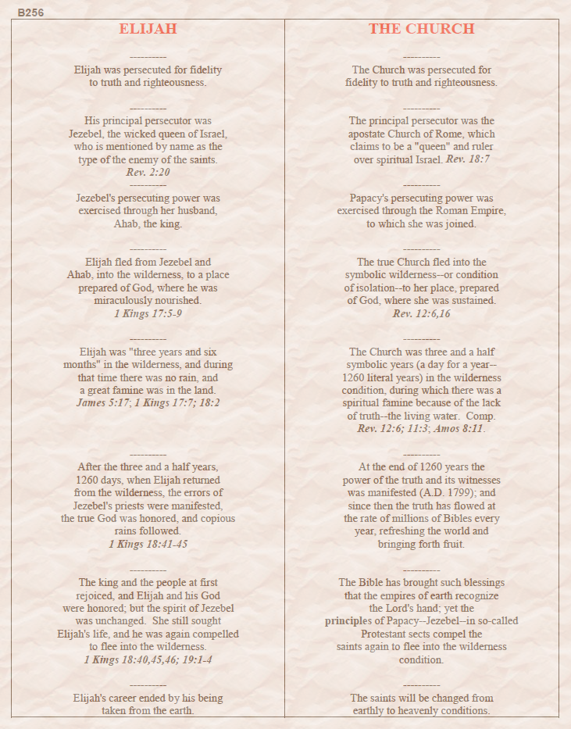
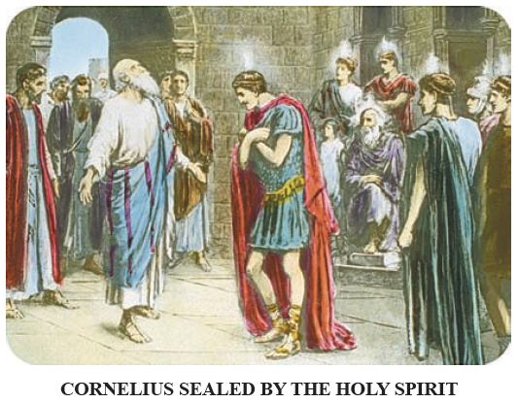
Lesson 1: Let no man take your crown.
Volume 2 page 256

Slide 18
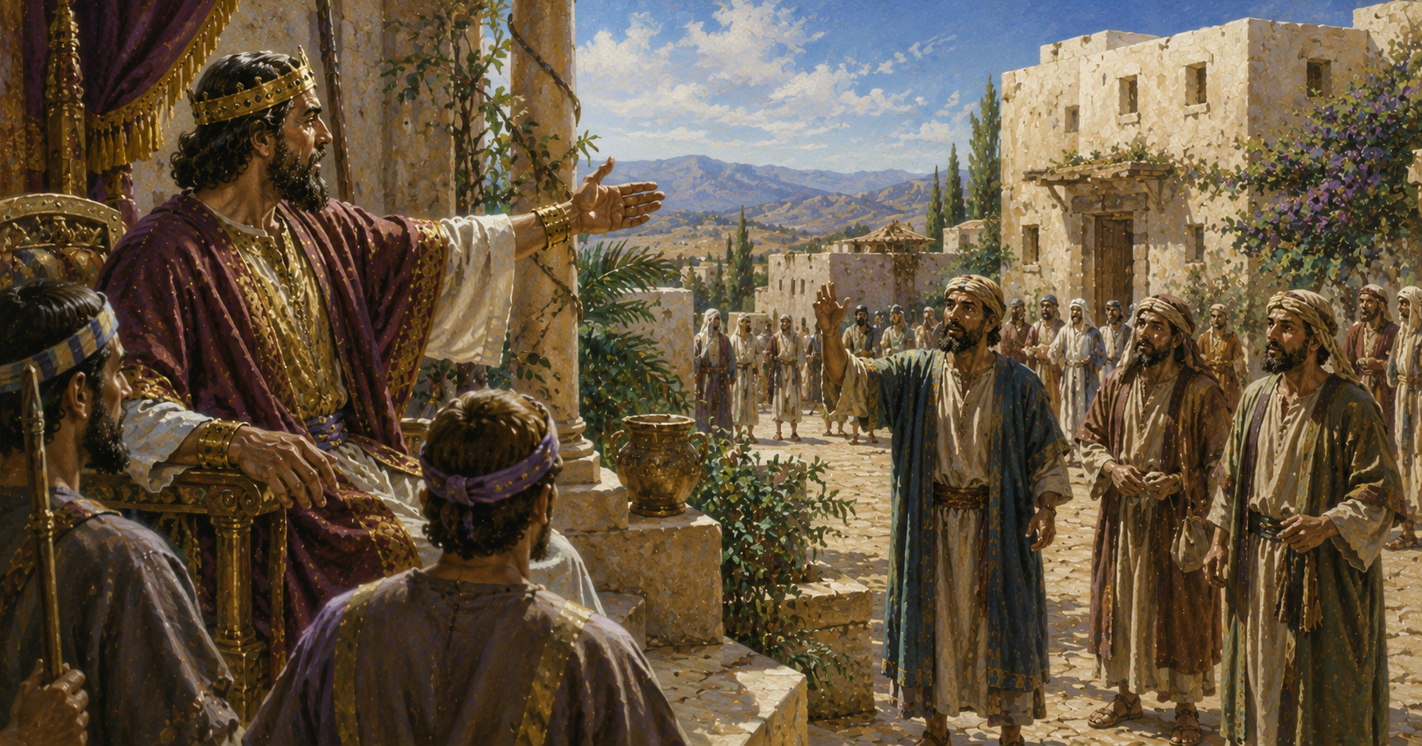
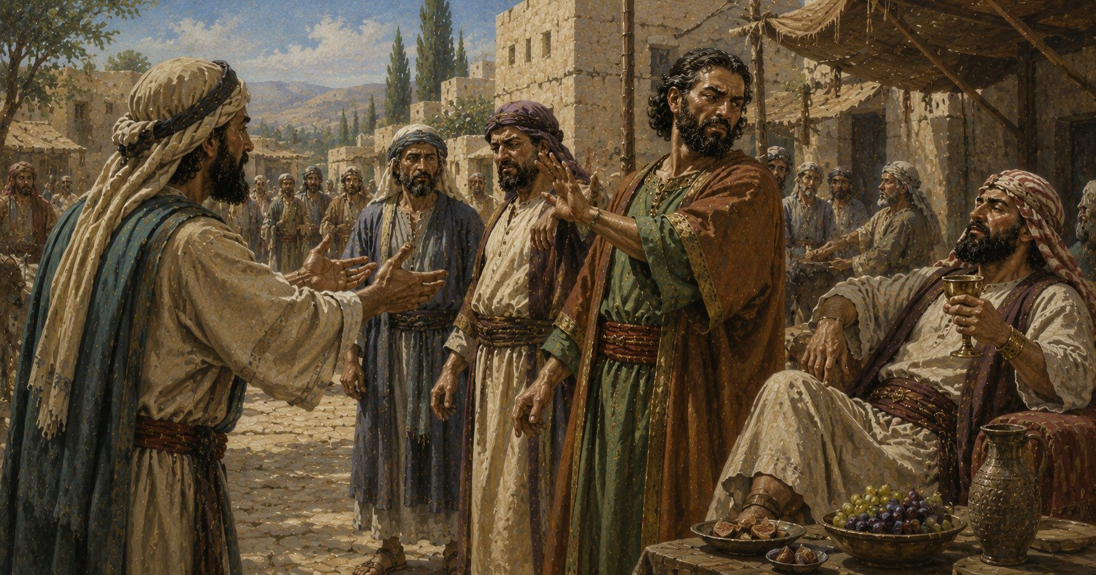
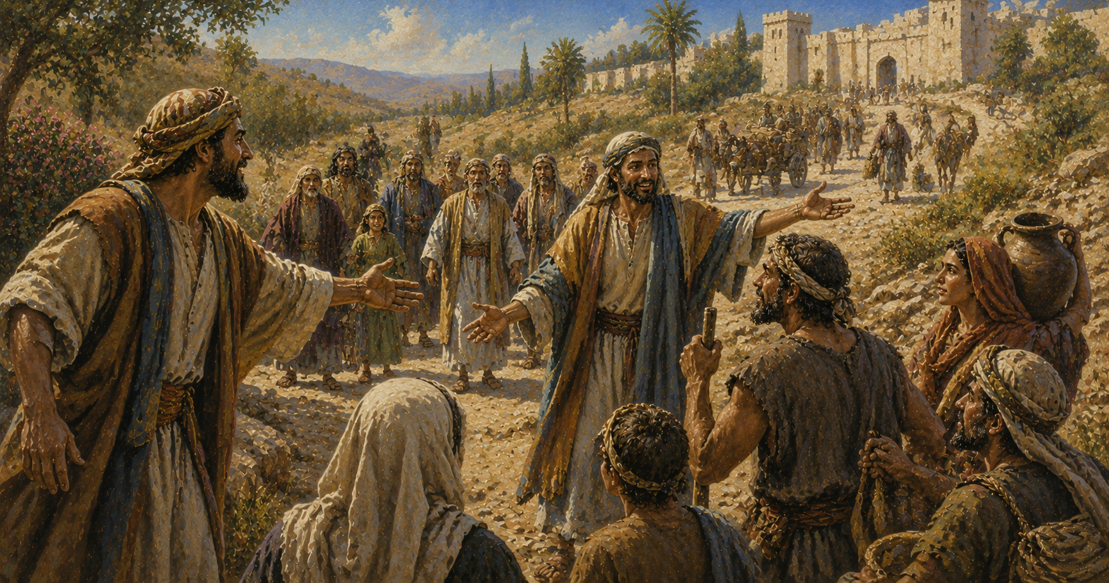
Lesson 1: Let no man take your crown.
Matthew 22:9 Go ye therefore into the highways, and as many as ye shall find, bid to the marriage.
Revelation 3:11 Behold, I come quickly: hold that fast which thou hast, that no man take thy crown.

Slide 19
Part 1: The Widow
Let no man take your crown.
Sometimes, God requires faith before deliverance.
Part 2: The Meal and the Oil
It requires faith to understand that God has provided what we need to make our calling and election sure.
We need to combine our spiritual ingredients to produce something acceptable to our calling.
Part 3: Elijah
God will deliver us, but we need to recognize and accept His deliverance when it comes.
God will deliver us, but deliverance isn’t always a passive experience.

Slide 20
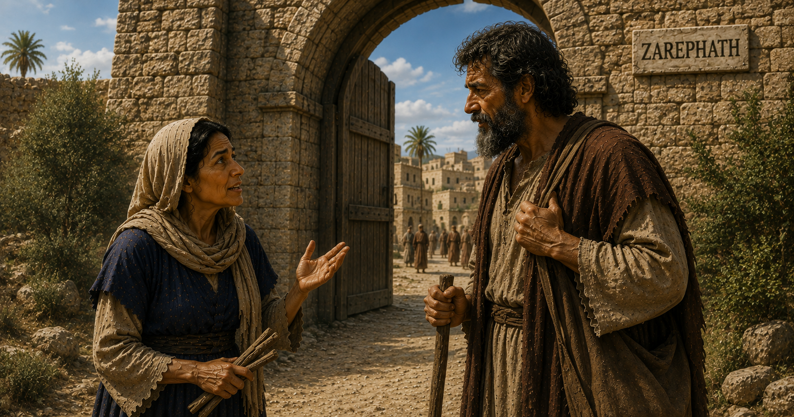
Lesson 2: Sometimes, God requires faith before deliverance.
1 Kings 17:12 And she said, As the LORD thy God liveth, I have not a cake, but an handful of meal in a barrel, and a little oil in a cruse: and, behold, I am gathering two sticks, that I may go in and dress it for me and my son, that we may eat it, and die.

Slide 21
Lesson 2: Sometimes, God requires faith before deliverance.

Slide 22
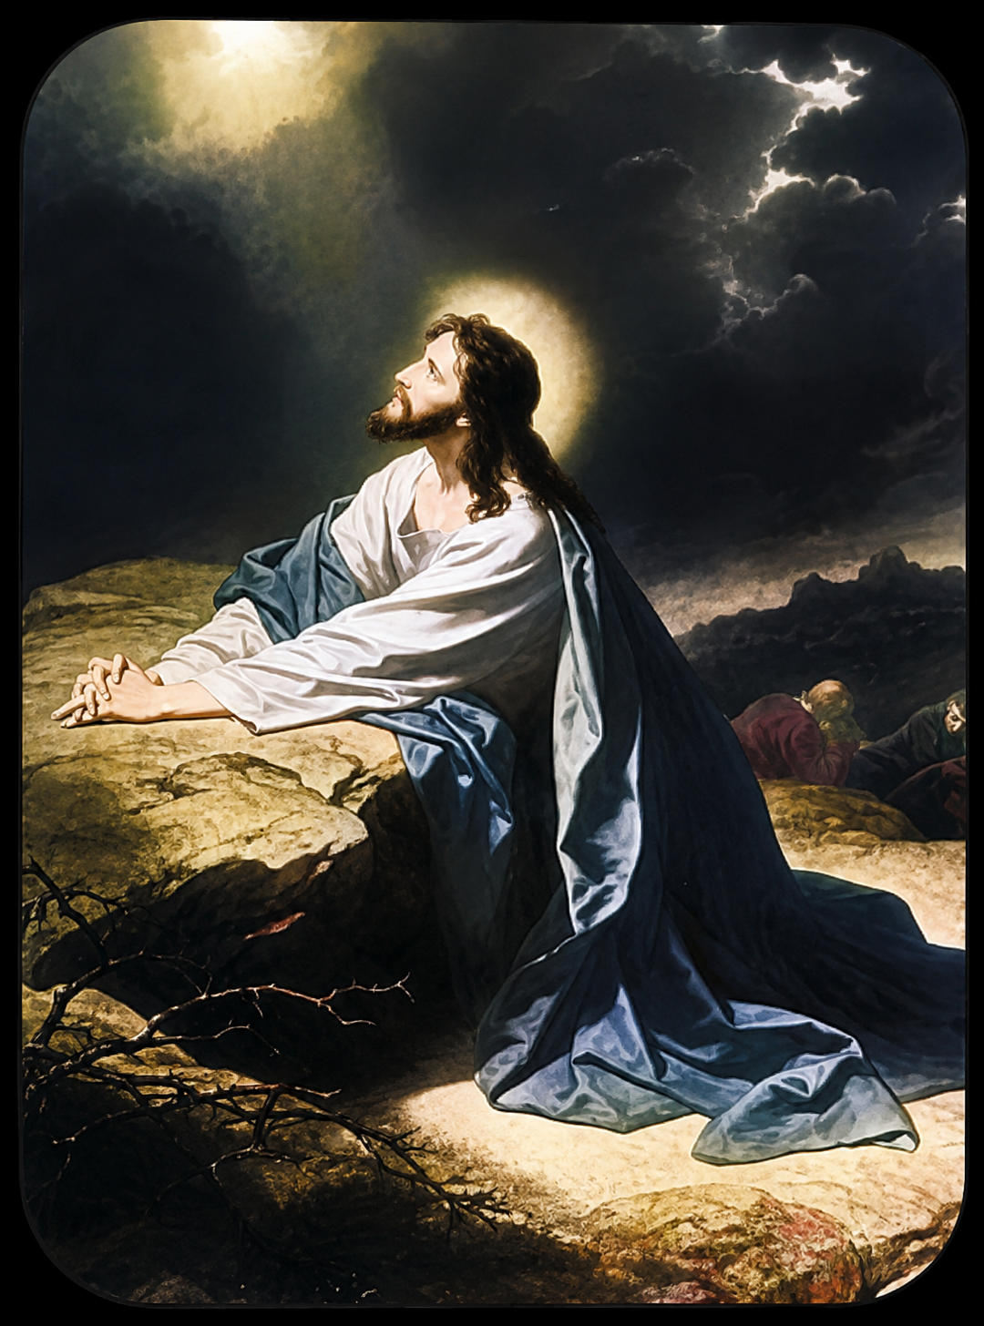
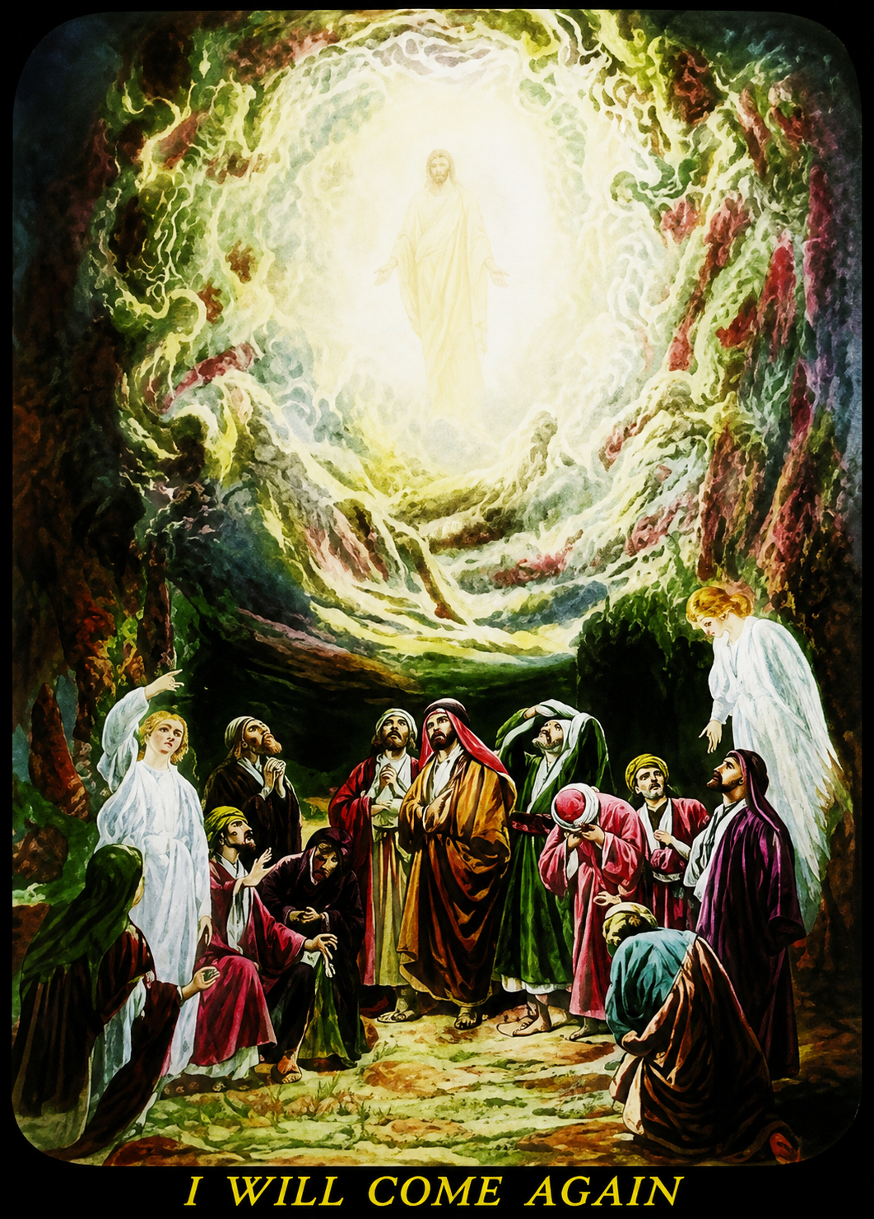
Lesson 2: Sometimes, God requires faith before deliverance.
Matthew 26:39 And he went a little farther, and fell on his face, and prayed, saying, O my Father, if it be possible, let this cup pass from me: nevertheless not as I will, but as thou wilt.
Romans 8:34 Who is he that condemneth? It is Christ that died, yea rather, that is risen again, who is even at the right hand of God, who also maketh intercession for us.

Slide 23
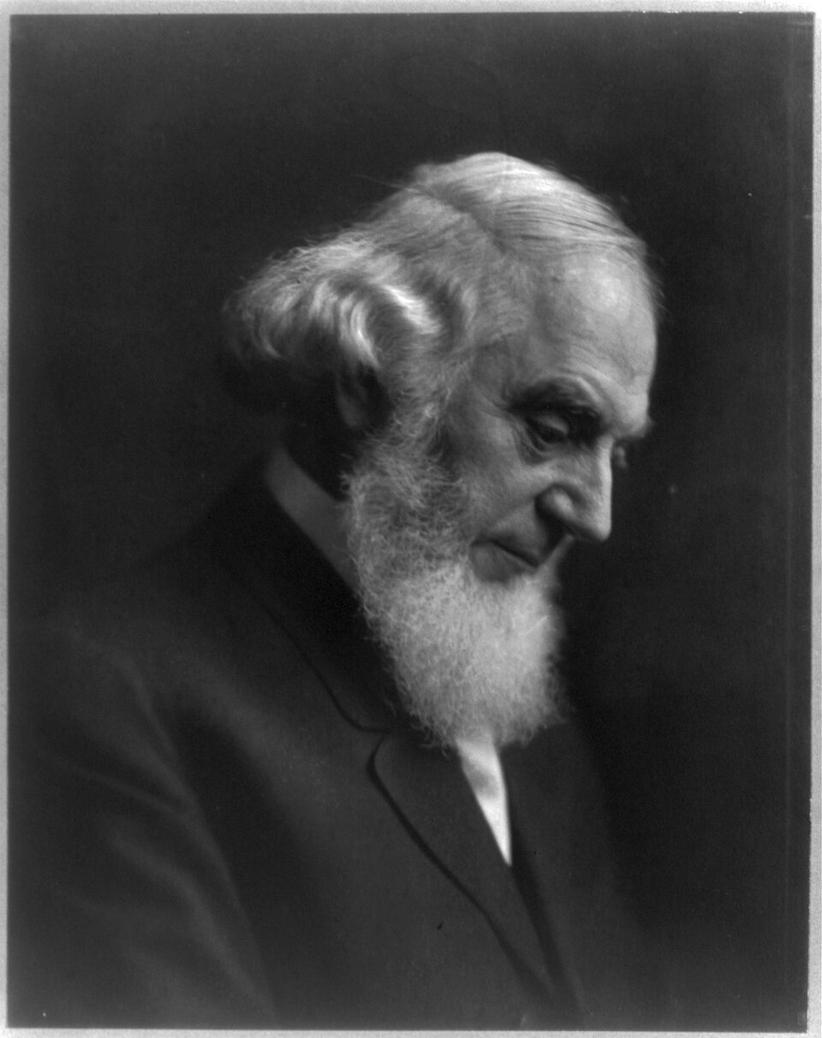
Lesson 2: Sometimes, God requires faith before deliverance.
If the woman had the faith necessary to obey, then she would be esteemed worthy of the Lord's assistance through the Prophet; if she did not exercise the faith, another widow might have been found who would. Thus it is with us, – at various steps in the journey of life the Lord brings us to the place where he tests our faith. If we exercise the faith we will get the blessing; if we do not, we will lose it. "Without faith it is impossible to please God." Nevertheless the woman was not asked to exercise this faith without being first given a definite promise from the Lord; and so with us – we are not to be blindly credulous respecting the words and promises of men, and to consider this to be faith in the Lord; but when we recognize the word of the Lord, we are to trust it implicitly, and to act accordingly. – R2326

Slide 24
Part 1: The Widow
Let no man take your crown.
Sometimes, God requires faith before deliverance.
Part 2: The Meal and the Oil
It requires faith to understand that God has provided what we need to make our calling and election sure.
We need to combine our spiritual ingredients to produce something acceptable to our calling.
Part 3: Elijah
God will deliver us, but we need to recognize and accept His deliverance when it comes.
God will deliver us, but deliverance isn’t always a passive experience.

Slide 25
1 Kings 17:16 And the barrel of meal wasted not, neither did the cruse of oil fail, according to the word of the LORD, which he spake by Elijah.

Slide 26
Part 1: The Widow
Let no man take your crown.
Sometimes, God requires faith before deliverance.
Part 2: The Meal and the Oil
It requires faith to understand that God has provided what we need to make our calling and election sure.
We need to combine our spiritual ingredients to produce something acceptable to our calling.
Part 3: Elijah
God will deliver us, but we need to recognize and accept His deliverance when it comes.
God will deliver us, but deliverance isn’t always a passive experience.

Slide 27
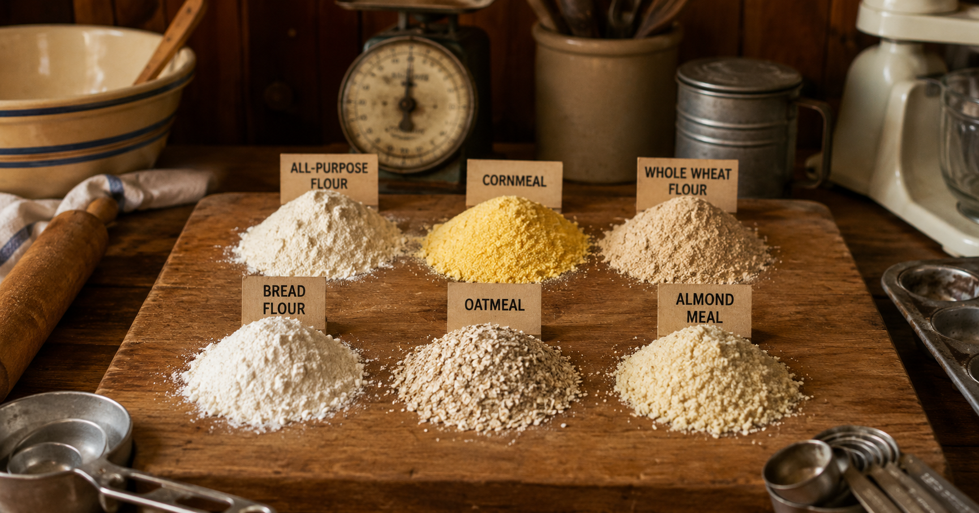
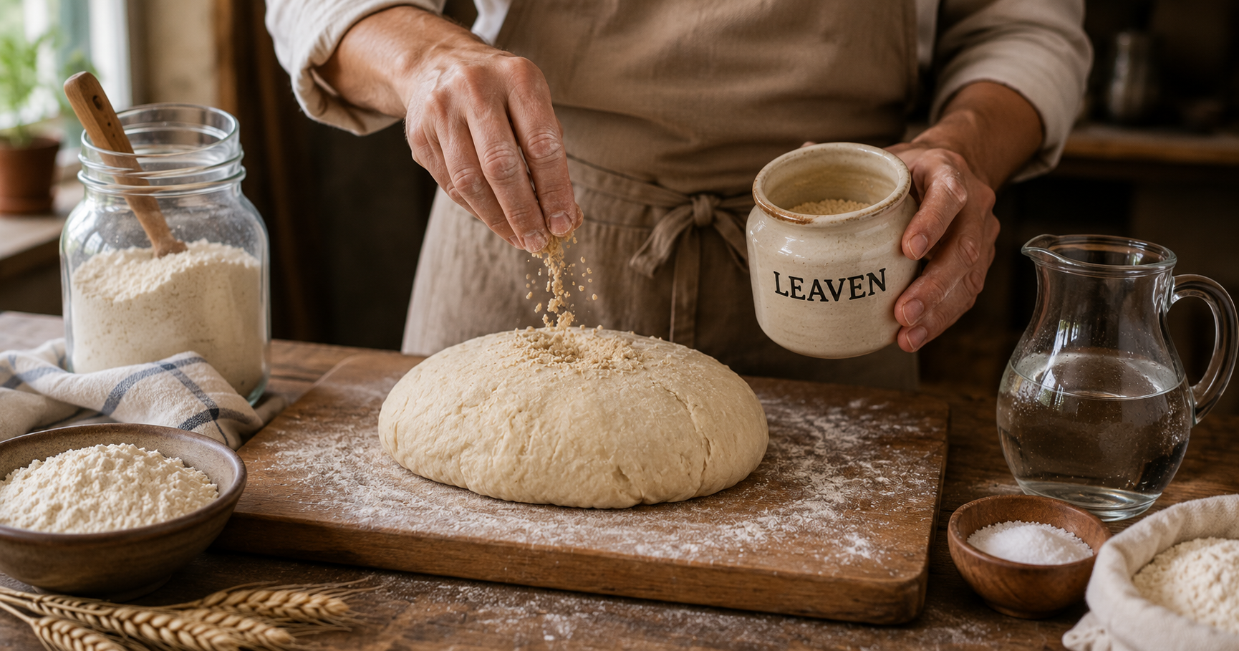
1 Corinthians 5:6 Your glorying is not good. Know ye not that a little leaven leaveneth the whole lump?
5:8 Therefore let us keep the feast, not with old leaven, neither with the leaven of malice and wickedness; but with the unleavened bread of sincerity and truth.

Slide 28

Lesson 1: It requires faith to understand that God has provided what we need to make our calling and election sure.
Daniel 12:4 But thou, O Daniel, shut up the words, and seal the book, even to the time of the end: many shall run to and fro, and knowledge shall be increased.

Slide 29
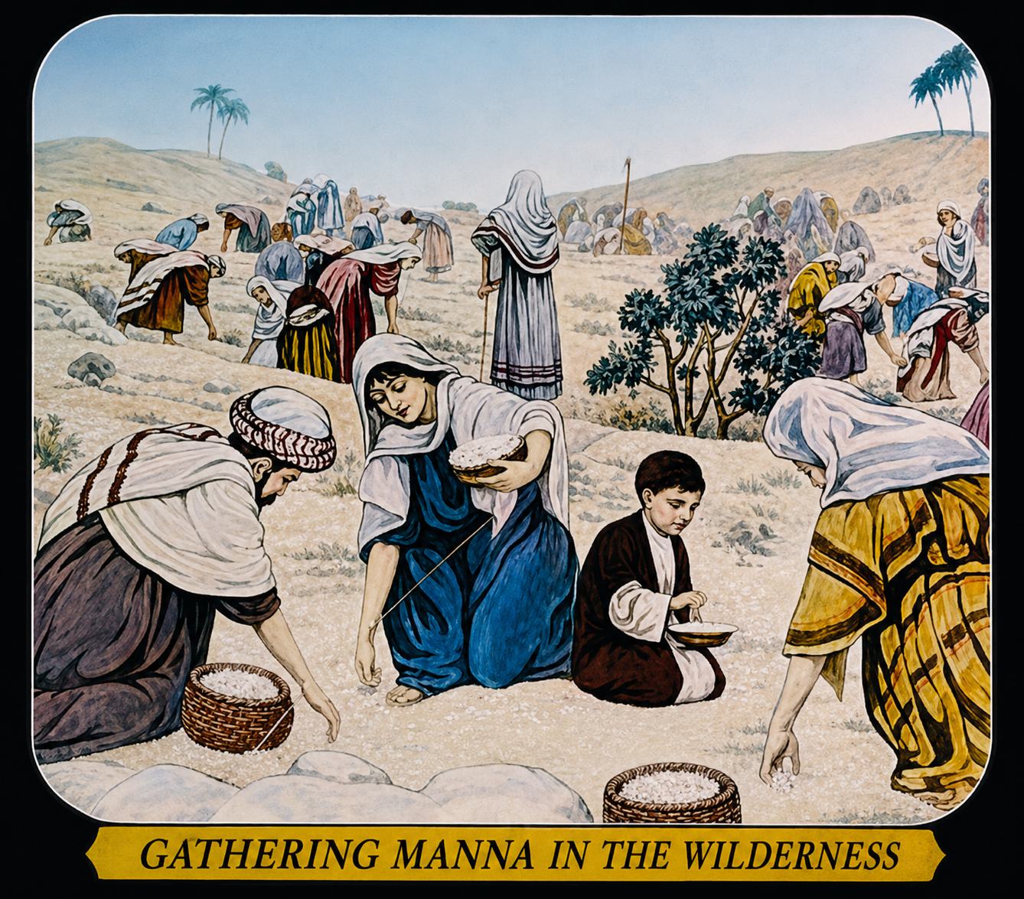
Numbers 11:4 And the mixed multitude that was among them fell a lusting: and the children of Israel also wept again, and said, Who shall give us flesh to eat?
11:5 We remember the fish, which we did eat in Egypt freely; the cucumbers, and the melons, and the leeks, and the onions, and the garlic:
Numbers 11:6 But now our soul is dried away: there is nothing at all, beside this manna, before our eyes.

Slide 30
Part 1: The Widow
Let no man take your crown.
Sometimes, God requires faith before deliverance.
Part 2: The Meal and the Oil
It requires faith to understand that God has provided what we need to make our calling and election sure.
We need to combine our spiritual ingredients to produce something acceptable to our calling.
Part 3: Elijah
God will deliver us, but we need to recognize and accept His deliverance when it comes.
God will deliver us, but deliverance isn’t always a passive experience.

Slide 31
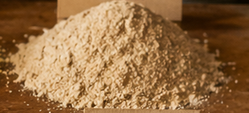
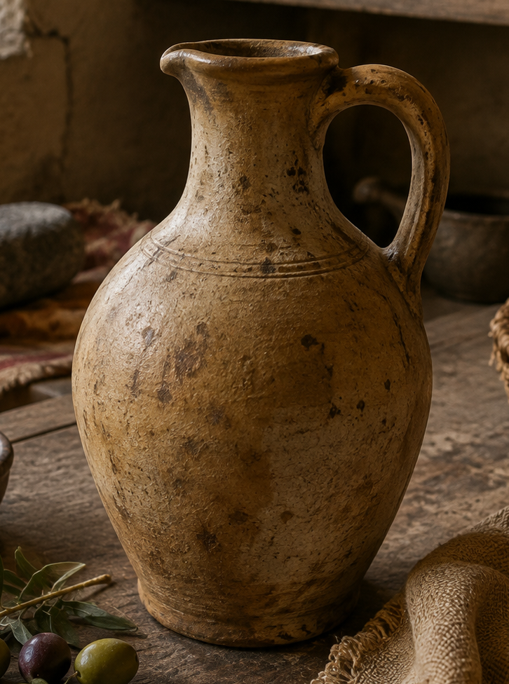
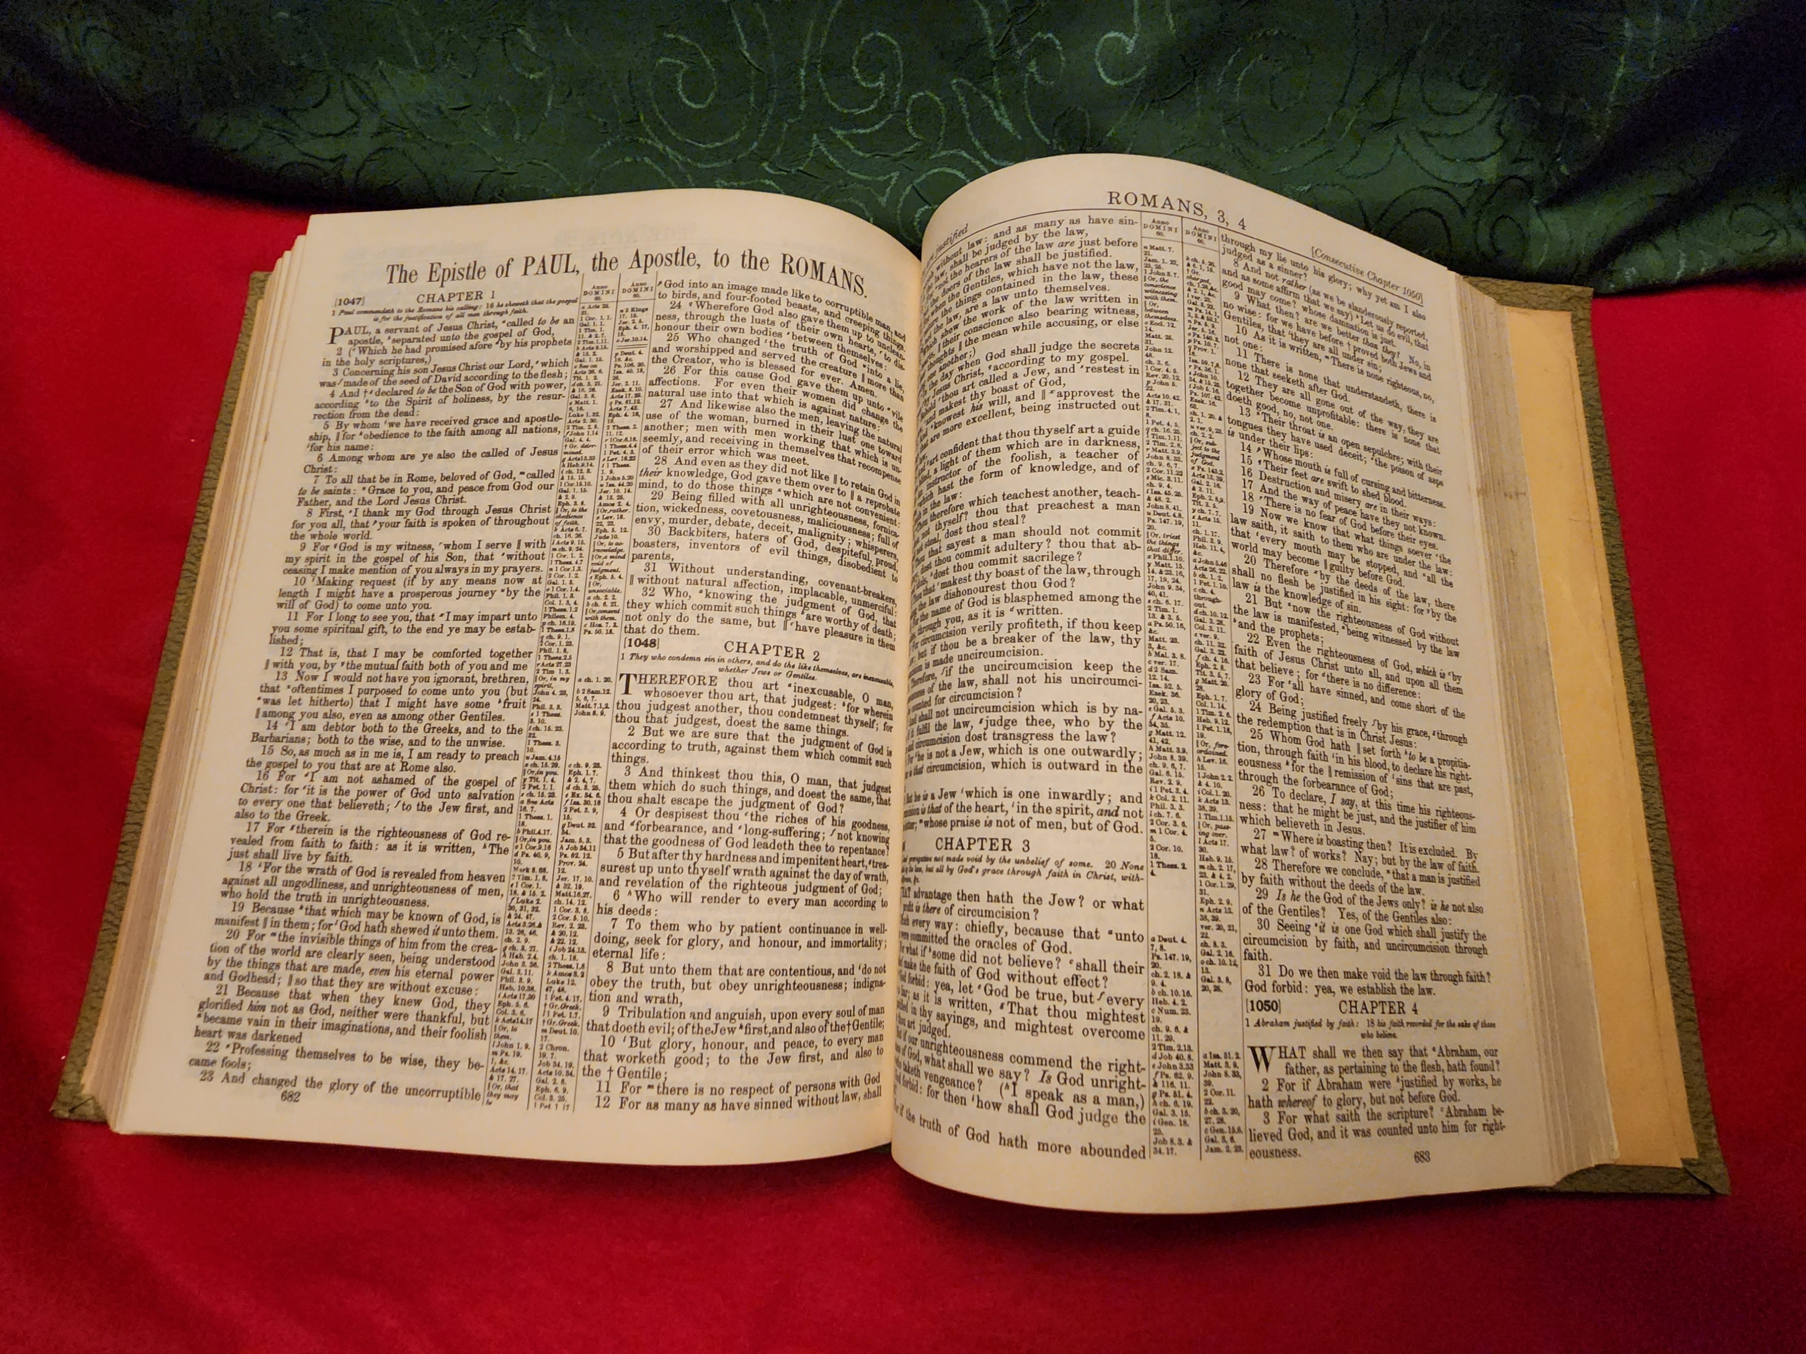
Lesson 2: We need to combine our spiritual ingredients to produce something acceptable to our calling.
+
+

Slide 32
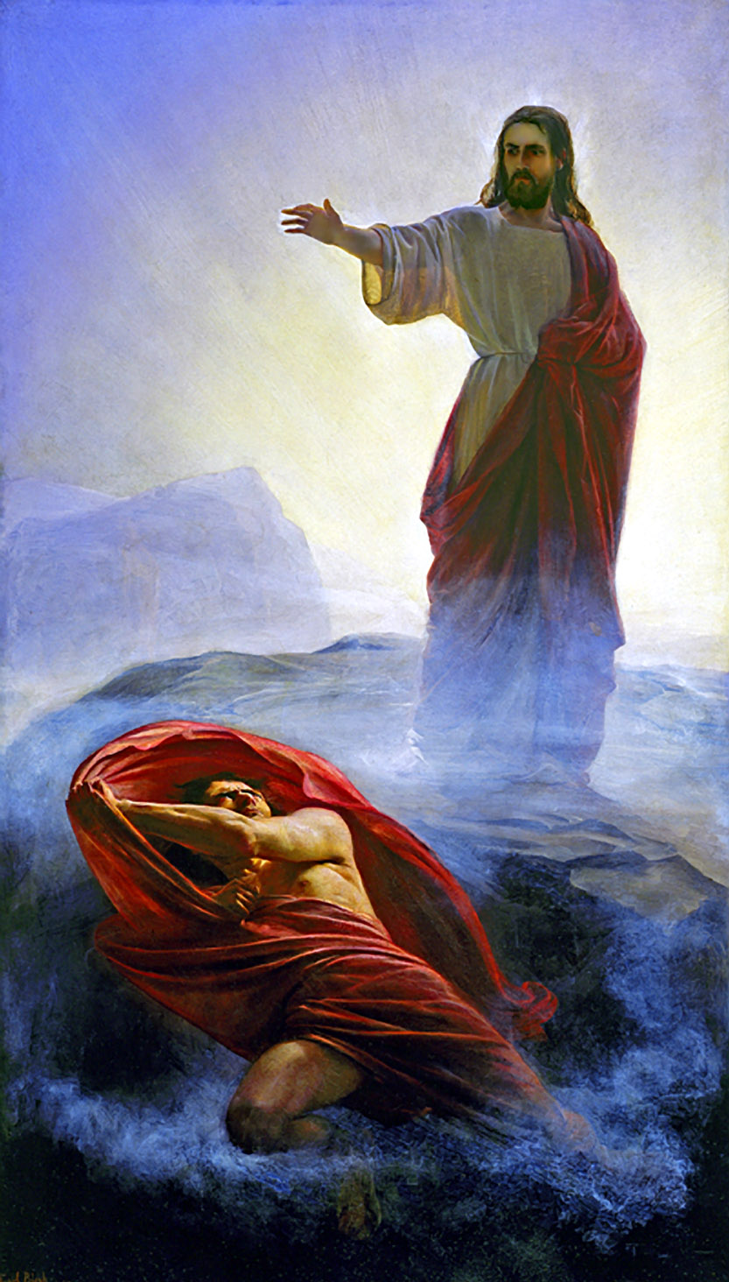
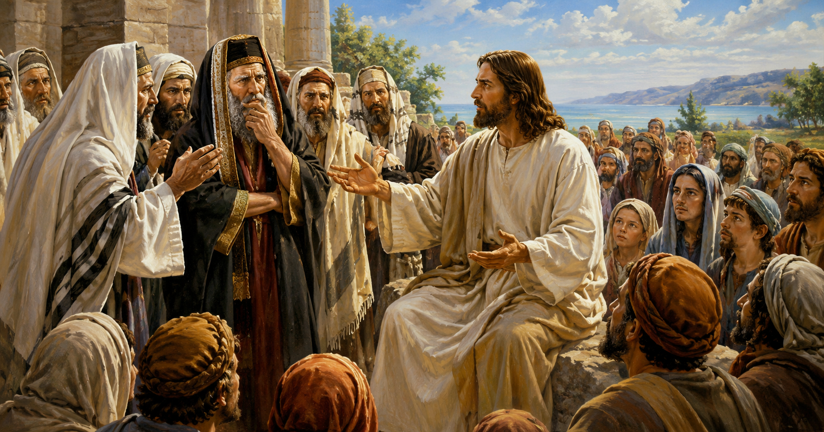
Lesson 2: We need to combine our spiritual ingredients to produce something acceptable to our calling.
1 Peter 4:12 Beloved, think it not strange concerning the fiery trial which is to try you, as though some strange thing happened unto you:
John 13:16 … The servant is not greater than his lord; neither he that is sent greater than he that sent him.

Slide 33
Part 1: The Widow
Let no man take your crown.
Sometimes, God requires faith before deliverance.
Part 2: The Meal and the Oil
It requires faith to understand that God has provided what we need to make our calling and election sure.
We need to combine our spiritual ingredients to produce something acceptable to our calling.
Part 3: Elijah
God will deliver us, but we need to recognize and accept His deliverance when it comes.
God will deliver us, but deliverance isn’t always a passive experience.

Slide 34
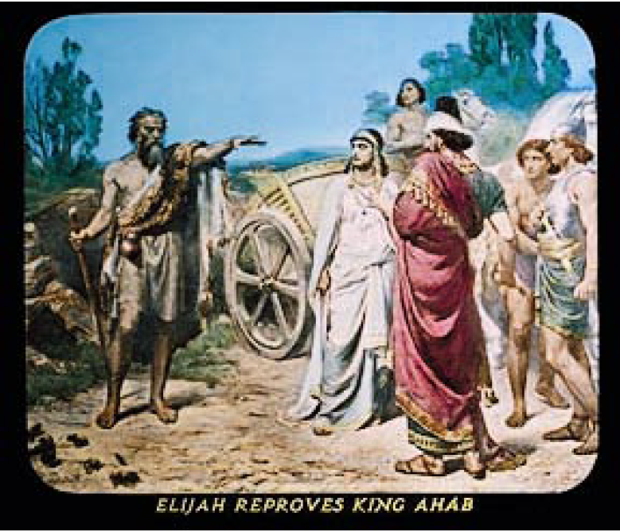
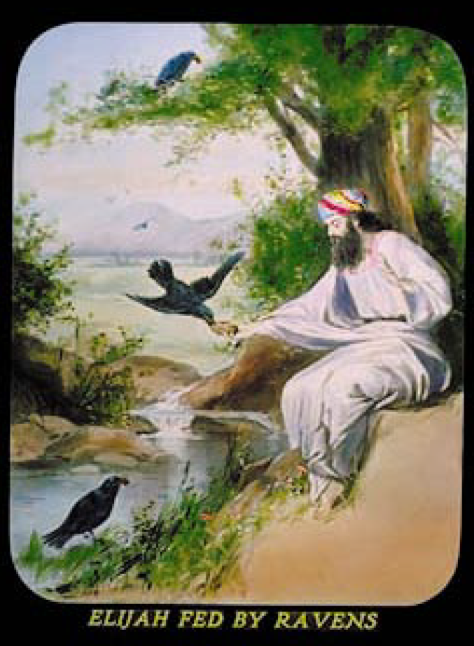
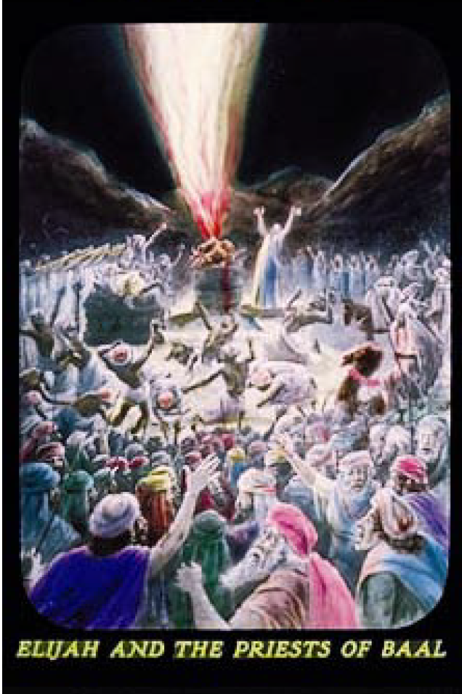
Elijah – A Servant of God During a Difficult Time

Slide 35
Part 1: The Widow
Let no man take your crown.
Sometimes, God requires faith before deliverance.
Part 2: The Meal and the Oil
It requires faith to understand that God has provided what we need to make our calling and election sure.
We need to combine our spiritual ingredients to produce something acceptable to our calling.
Part 3: Elijah
God will deliver us, but we need to recognize and accept His deliverance when it comes.
God will deliver us, but deliverance isn’t always a passive experience.

Slide 36
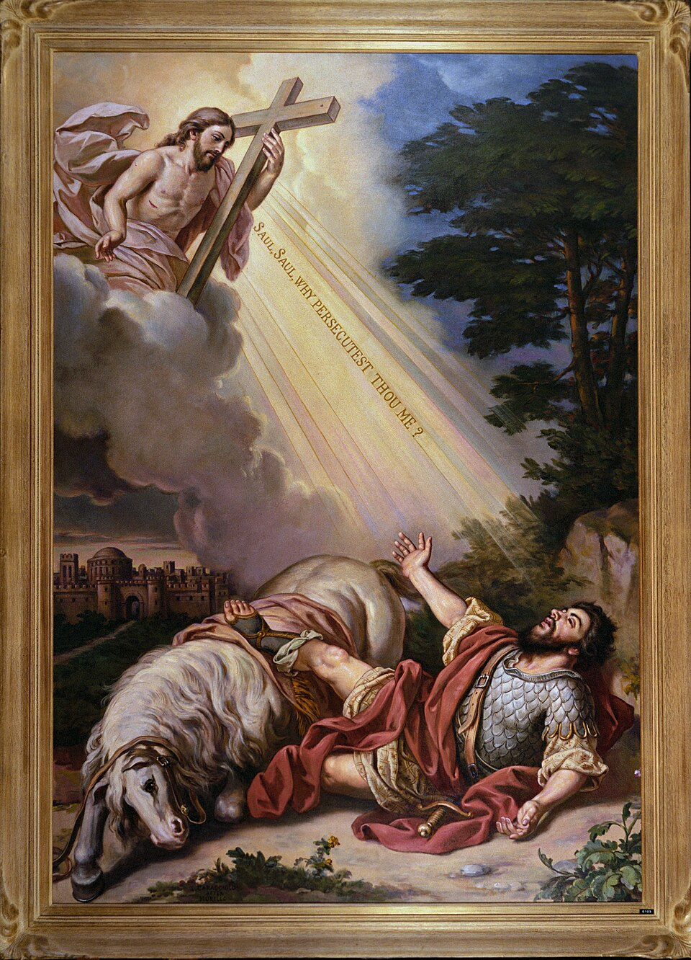
“Not always, or even often, does God deal with his people after this manner of miraculous provision for their sustenance. Nevertheless, we are to recognize him as the author of all our blessings…” – R2326
2 Corinthians 12:9 And he [the Lord] said unto me, My grace is sufficient for thee: for my strength is made perfect in weakness. Most gladly therefore will I rather glory in my infirmities, that the power of Christ may rest upon me.
Ephesians 5:15 See then that ye walk circumspectly, not as fools, but as wise,
5:17 Wherefore be ye not unwise, but understanding what the will of the Lord is.

Slide 37
Part 1: The Widow
Let no man take your crown.
Sometimes, God requires faith before deliverance.
Part 2: The Meal and the Oil
It requires faith to understand that God has provided what we need to make our calling and election sure.
We need to combine our spiritual ingredients to produce something acceptable to our calling.
Part 3: Elijah
God will deliver us, but we need to recognize and accept His deliverance when it comes.
God will deliver us, but deliverance isn’t always a passive experience.

Slide 38
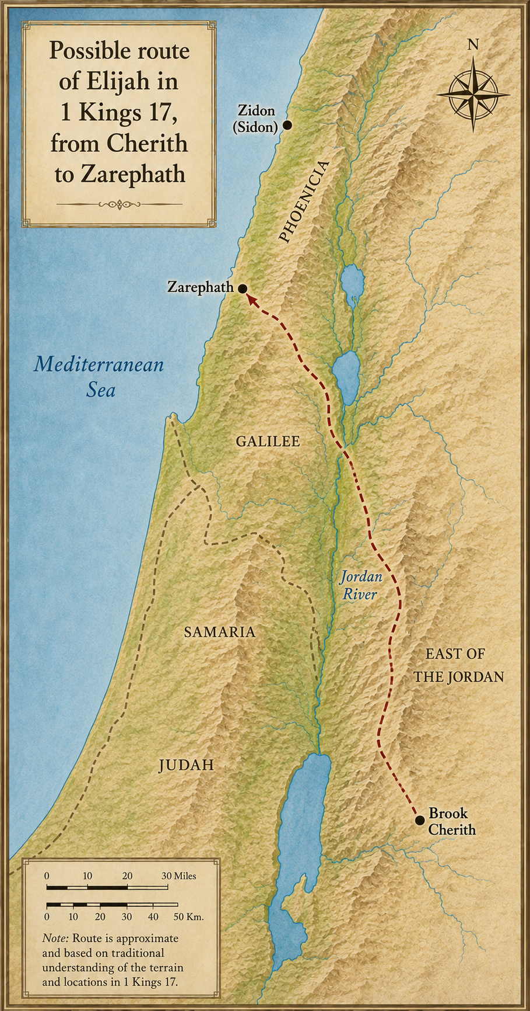
Lesson 2: God will deliver us, but deliverance isn’t always a passive experience.
1 Kings 17:8 And the word of the LORD came unto him, saying,
17:9 Arise, get thee to Zarephath, which belongeth to Zidon, and dwell there: behold, I have commanded a widow woman there to sustain thee.

Slide 39
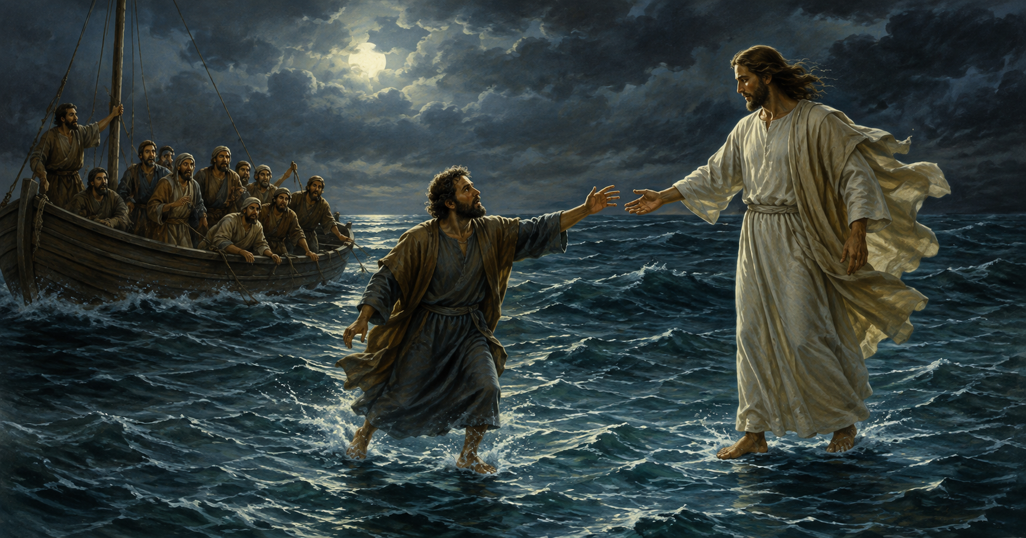
Lesson 2: God will deliver us, but deliverance isn’t always a passive experience.
James 2:17 Even so faith, if it hath not works, is dead, being alone.
1 Corinthians 9:27 But I keep under my body, and bring it into subjection: lest that by any means, when I have preached to others, I myself should be a castaway.

Slide 40
In Summary

Slide 41
Part 1: The Widow
Let no man take your crown.
Sometimes, God requires faith before deliverance.
Part 2: The Meal and the Oil
It requires faith to understand that God has provided what we need to make our calling and election sure.
We need to combine our spiritual ingredients to produce something acceptable to our calling.
Part 3: Elijah
God will deliver us, but we need to recognize and accept His deliverance when it comes.
God will deliver us, but deliverance isn’t always a passive experience.

